Slide 1


Slide 2
Grade 10 & 11 Parent Info Night
There are so many options and pathways in high school that it can be overwhelming
Tonight's Goal is to “HELP you HELP your child”, by:
Equipping you to make informed decisions about your child’s high school education
Equipping you to make informed decisions about your child’s post-secondary pathway by introducing you to the TOOLS we use in Guidance

Slide 3
Agenda
Introduction
Review highlights of www.trinitycatholic.ca
Pathways
  Skilled Trades
  College
  University
  Workplace
Conclusion
Questions

Slide 4
WWW.TRINITYCATHOLIC.CA

Slide 5
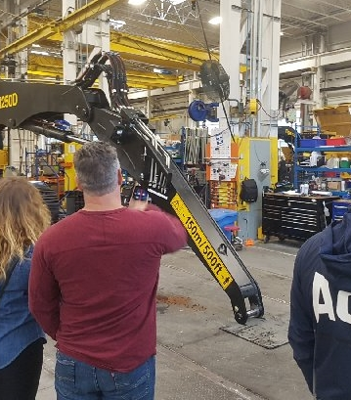
Skilled Trades
By Ms. Deroo

Slide 6
Topics
What are the Skilled Trades
Understanding Apprenticeship
Benefits
Challenges
Cost of Education
Financial opportunity
Steps required in High School
Valuable online resources

Slide 7

"There's a problem on our horizon: Ontario is facing a shortage of workers in the skilled trades. The solution is clear. We need to let young people and their parents know that a career in the trades is exciting, fulfilling, and lucrative. These are well-paying jobs." Monte McNaughton, Minister of Labour, Training and Skills Development

Slide 8

What are the Skilled Trades
A career path that requires hands-on work, technical knowledge & capabilities
  https://youtu.be/okIB65YlwaM
“The Future belongs to those who build it”

Slide 9
What are the Skilled Trades
There are 140+ trades in 4 Sectors
  Construction
  Motive Power
  Industrial
  Service

Slide 10
What is an Apprenticeship?
It is an on-the-job training program for those interested in pursuing a career in the Skilled Trades.
80-90% on the job training
10-20% in-class learning

Slide 11
5 Steps to becoming an Apprentice
1. Finish High School
2. Choose a Trade
3. Get Hired
4. Register & Train
5. Start your career!

Slide 12
Benefits to a career in the Skilled Trades
Earn while you learn
Use your skill, judgement & creativity
Use of cutting-edge technology
Many paths to advance
Hard work
Transferable skills
Job Security
Opportunities for Skilled Trade Labourers without certification

Slide 13
Challenges to a career in the Skilled Trades
Average age of hire
Being registered as an apprentice
Aging journeyman
Location, Location, Location
Math and Physics
Financial responsibility
Hard work (physical labour)

Slide 14
Why complete an apprenticeship?
The goal is to gain certification ("Ticket")
Once ticketed a person is qualified to work in the industry without supervision
Earning power increases as credentials increase

Slide 15

Progression of an Apprentice

Slide 16
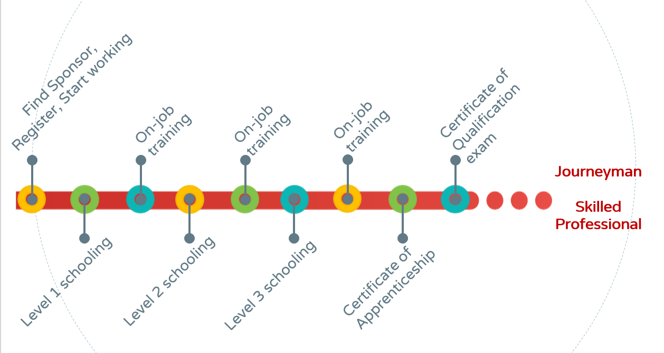

Slide 17
How much does it cost to be an apprentice?
On-the-job - Apprentices are paid
In school
  Tuition is approx $500
  Government assistance
Cost of tools (grants available)

Slide 18
FINDING A JOB
The
Struggle is REAL
HOW CAN I HELP MY CAUSE
  Build a Network
  High school tech courses
  High school COOP/OYAP
  Part time Job

Slide 19
What if I STILL cannot find a job?
College Certificate
  Pre-Apprenticeship programs
  < 1 year
  Gain skills & experience
  Possibility of challenging LEVEL I
College Diploma
  2-3 year program
  Gain skills & experience
  Possibility of challenging LEVEL II

Slide 20

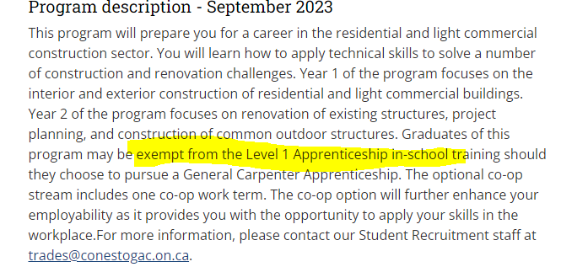

Slide 21

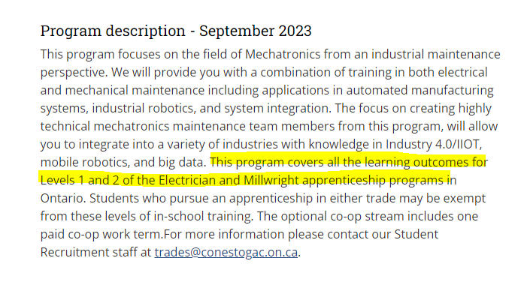

Slide 22
Importance of Financial Management
Early years
Earning potential
Geographic mobility
Limited education costs
Staged wage increases
Seasonal wages – yearly budgeting
Later Years
Potential physical limitations
  Did you create your own pension?
  Will you have a business to sell?
  Will you be interested in teaching? Inspector?

Slide 23

Financial opportunity of a career in the Trades

Slide 24
Suggested steps in high school
Tech courses
COOP/OYAP**
Math and Physics courses
Network - Job Shadow/Pt Job
Drivers License
Online assessments
YouTube videos

Slide 25
Valuable Websites
Home - OYAP Skilled Trades
https://www.ontario.ca/page/start-apprenticeship - start an apprenticeship, find out how to qualify and apply to be an apprentice
https://www.apprenticesearch.com/trades - list of trades with description
https://www.ontario.ca/page/skilled-trades - Find a career you wouldn't trade. Learn how to become a tradesperson, find resources if you're an employer, get job advice.
https://www.jobtalks.org/ - to watch video interviews about different trades
https://www.jobtalksconstruction.ca/ - watch interviews about construction trades
https://careersintrades.ca/what-are-the-skilled-trades/ - list of trades with Skills Canada description
http://workforceplanningboard.org/manufacturing-month/ - link to all BHN "We Make It Here" videos
www.ontariocolleges.ca - certificate and diploma research
www.skillscompetencescanada.com
https://caf-fca.org - Essential info about Canada's apprenticeship systems.

Slide 26
Videos and headlines
https://youtu.be/kSBElGtxGtQ - the We make it here (Norfolk) video
https://workforceplanningboard.org/journey-to-apprenticeship/
https://www.youtube.com/watch?v=CZWBOwFvR_8
https://youtu.be/SNNT8r7G6mE
https://youtu.be/okIB65YlwaM
https://news.ontario.ca/mol/en/2019/11/ontario-increasing-investments-in-skilled-trades.html

Slide 27
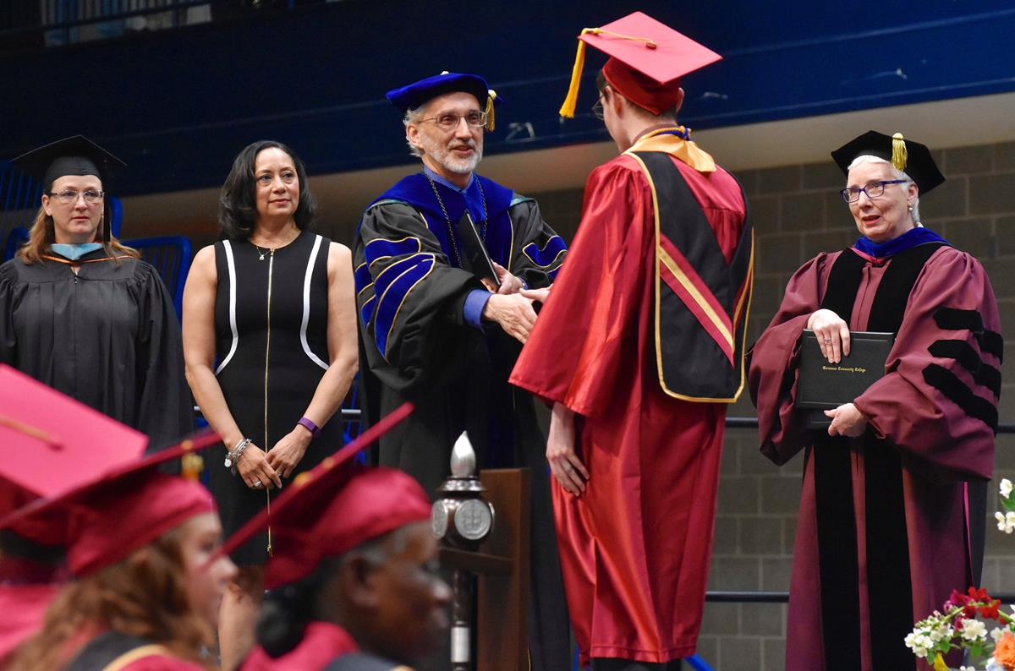
College
By Miss Aitken

Slide 28
Topics
Why Choose College?
Program Types
Tuition Costs
Competitive Programs
Valuable online resources

Slide 29
Why College?
Programs are designed to respond to the needs of the labour market and employers
Can have a local "flavour"
Quick to innovate and pivot with industry (200 new programs each year)

Slide 30
Why College?
Hands on, skill based, practical training
Smaller class sizes
Grads employable – 85% in 6 months (www.collegesontario.org)

Slide 31
Why College?
NO SURPRISES...
Employment focused
Students know exactly what they're going to get​
Example: Program of Study​

Slide 32
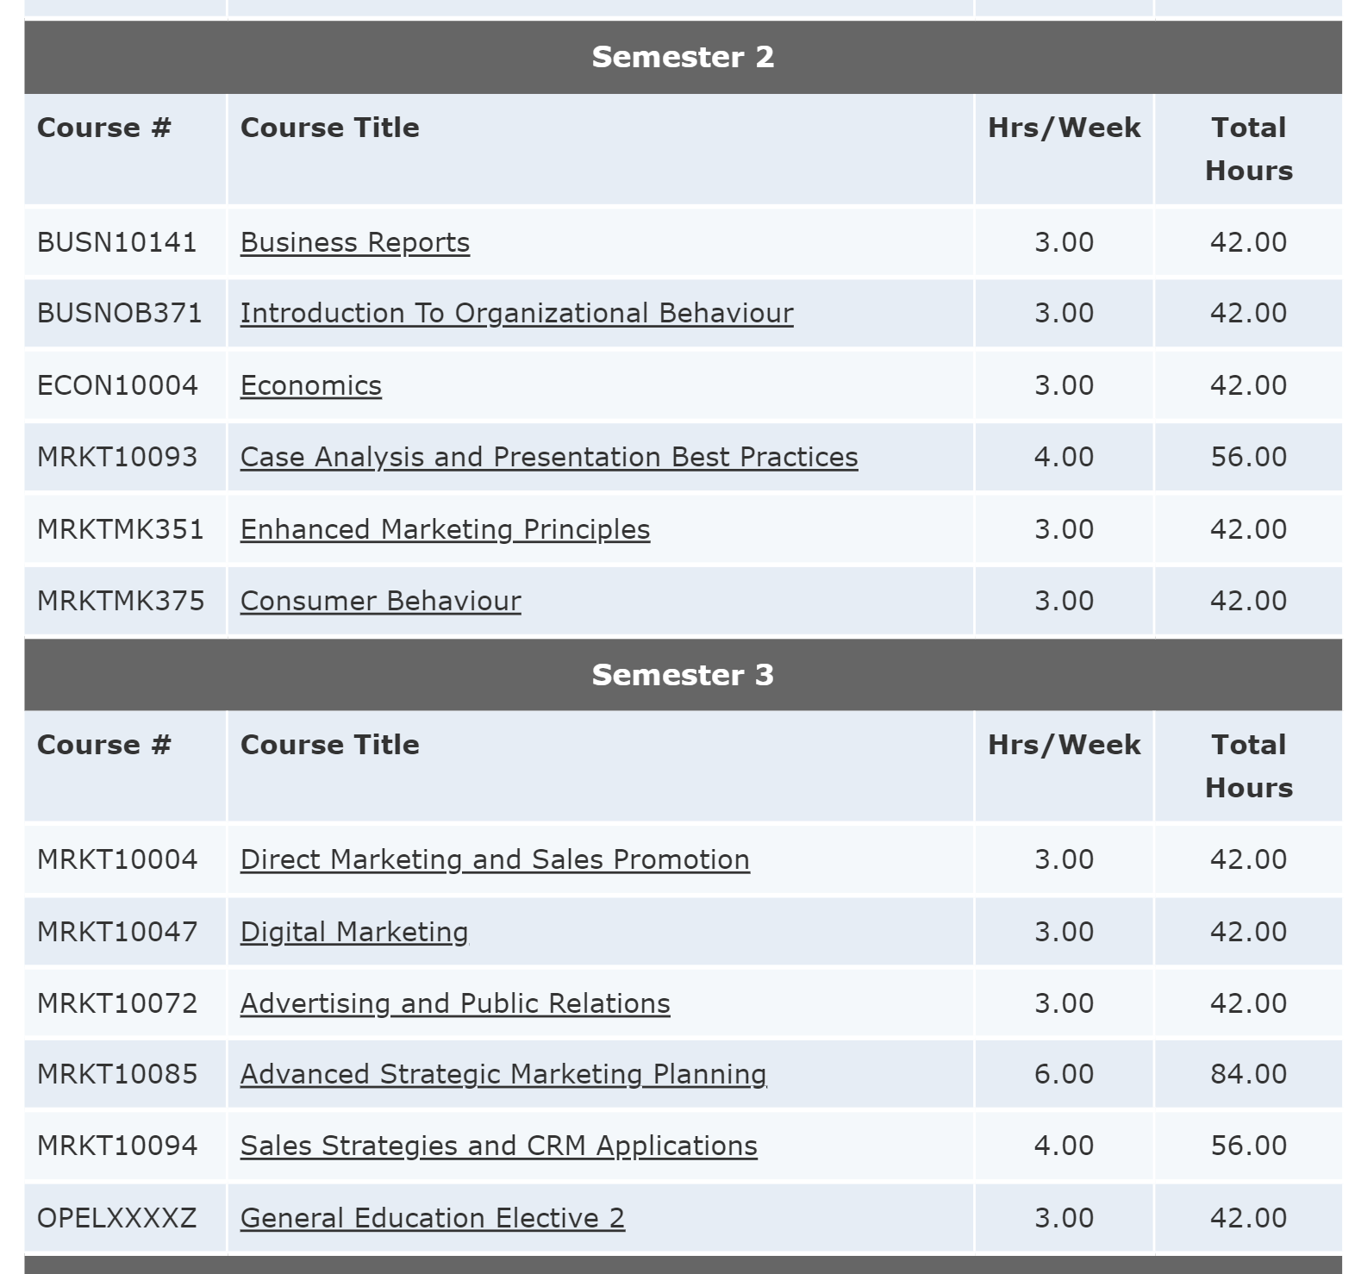

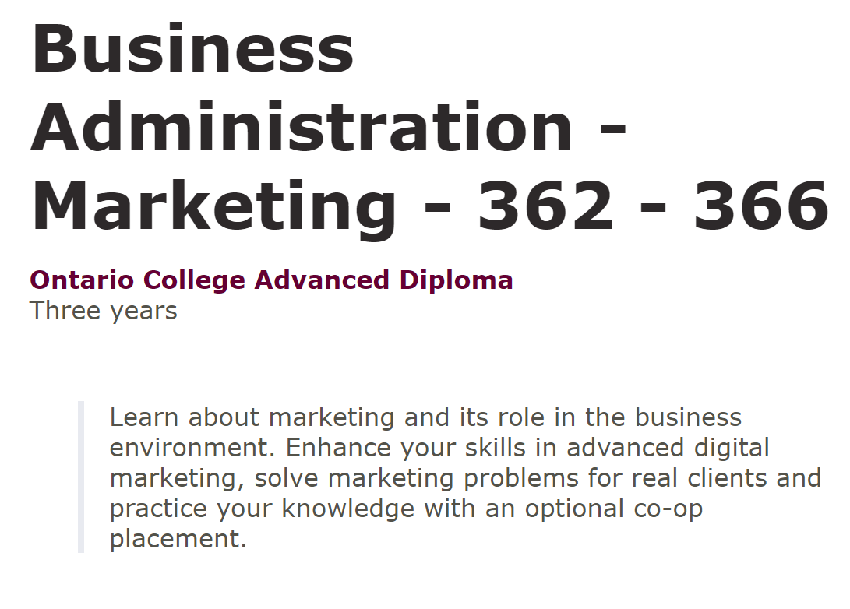

Slide 33
Why College?
Range of programs: 5,000 programs across 200-plus areas of study
Flexible delivery options – prep programs, bridge programs, university transfer agreements
Flexible start dates (Sept. Jan. May)

Slide 34
Why College?
Flexible Pathways
60,000 students transfer each year in Ontario
Numerous opportunities to move from college to university
www.ontransfer.ca or information on college sites
Notes:
I

Slide 35
College Programming
< 1 year certificate programs
2 –3 year diploma programs
Applied Degree programs
Collaborative Degree Programs
Post-Graduate Certificate programs

Slide 36
Admission Requirements
Look at Senior Level Credits – grades 11 and 12
Diploma Programs – Cannot demand U level classes
Some Workplace level options
Bachelor degrees – 6 grade 12 U/M
Notes:
It

Slide 37
Admission Requirements
Required vs Recommended
Grade differentials: C, M, U considered equal EXCEPT Conestoga
Certain programs – auditions, portfolios, HOAE, interviews/ Questionnaire

Slide 38


Slide 39
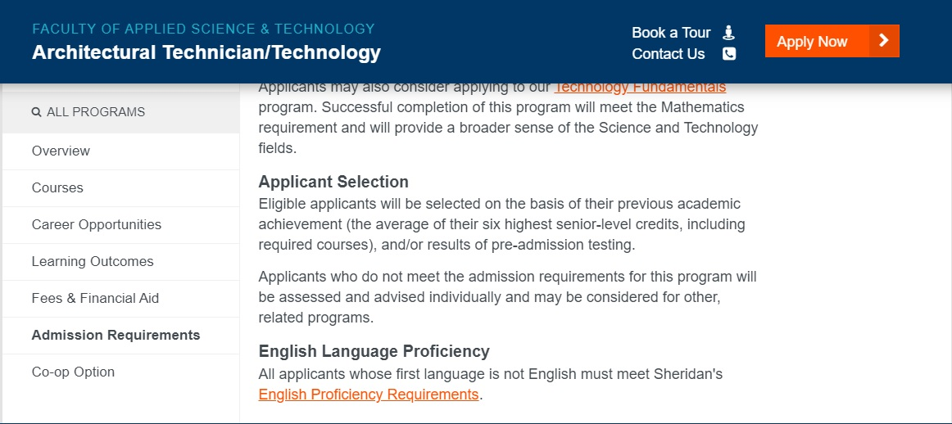

Slide 40
Competitive Programs
Definition
Examples: dental hygiene, practical nursing, paramedic, massage therapy, powerline tech, aviation
Caution – some have ZERO seats for high school students
Prep programs

Slide 41


Slide 42
Costs?
Average cost of tuition and compulsory fees for one year:
Diploma Program - $4,200
Certificate Program - $4,200
Graduate Certificate Programs - $5,500
Bachelor’s Degree Programs - $8,000
Other costs - $2,000 (include textbooks, supplies, coop fees)

Slide 43
Application
Equal Consideration Date – Feb. 1st
Nov. 1st – Earliest Offer Date
$110.00 to apply – 5 choices; up to 3 per school
Must confirm by May 1st
Application linked to OSAP

Slide 44
RESEARCH!
OPEN HOUSES! Fall and Spring opportunities.
Oct/ Nov Liaison Visits
College Panel Night!
Campus Tours/ Visits
Academic Advisors/ Recruitment Appts
CIP events (College Fairs)

Slide 45


Slide 46

College Mondays
Held every Monday in November
5 – 6 p.m.
Select date based on Colleges you are interested in
Program and Admission information

Slide 47
Resources
College Pathway
www.ontariocolleges.ca – Ontario college programs
www.ontransfer.ca – transfer agreements b/w college & university programs
https://www.collegesontario.org/en - updated college info
https://www.ouac.on.ca/guide/collaborative-university-college-programs/ – Collaborative Programs (college diploma & university degree)
KPIs – Key Performance Indicators
* We strongly encourage campus visits*

Slide 48
No IDEA?
Career Planning Tools / Quizzes – match student to program:
humbercareerfinder.com
ideagenerator.sheridancollege.ca
www.fanshawepathfinder.ca

Slide 49
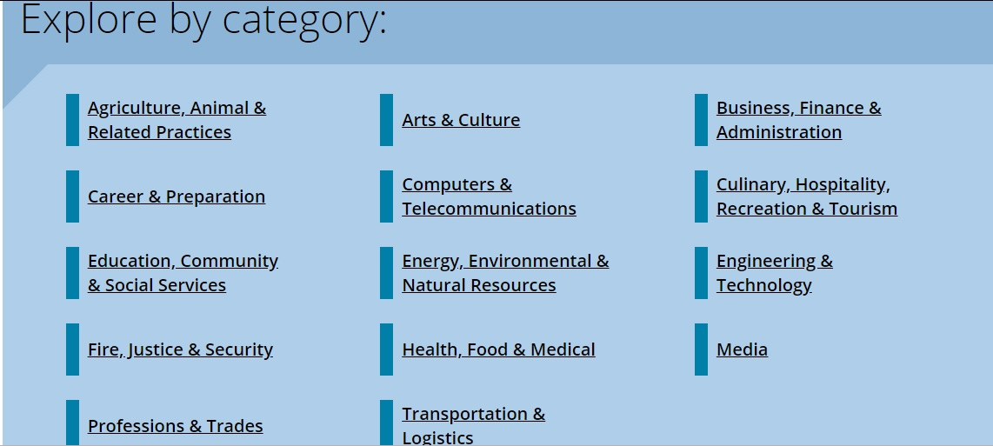

Slide 50

University
By Mrs. Deconinck O'Neail

Slide 51
Topics
Why University?
Prerequisites for University
Cost of University Education
Suggested steps in high school
Valuable online resources
Notes:
Here are the topics we are going to cover – why university, prerequisites, cost, suggested steps and online resources

Slide 52
Why University?
Many careers require university - doctors, teachers, lawyers, engineers, vets, registered nurses
May be a stepping stone to the next level of education i.e. Master's, PhD, Graduate certificate.
"Move up the ladder" and a stepping stone to higher goals
Many jobs require a Bachelor degree to be eligible for an interview
Notes:
S

Slide 53
Why University?
Teaches transferable skills desired by employers such as:
Ability to think critically
Collaborate
Communicate
Work under pressure
Solve theoretical problems
Unique opportunity to make social and industry connections through networking

Slide 54

Researching
University
www.ontariouniversitiesinfo.ca

Slide 55
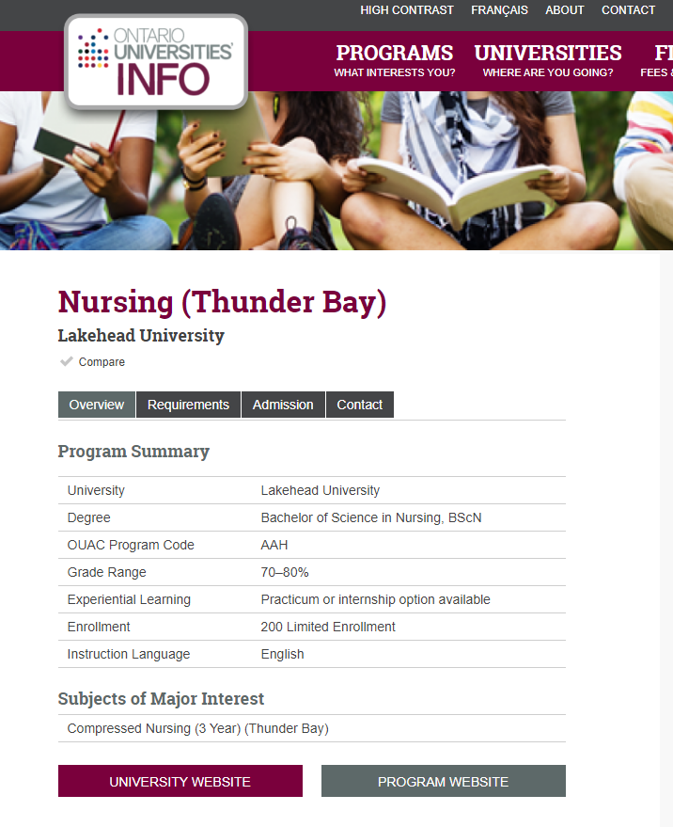
Finding University
Admission Average
https://www.ontariouniversitiesinfo.ca/programs/compare

Slide 56
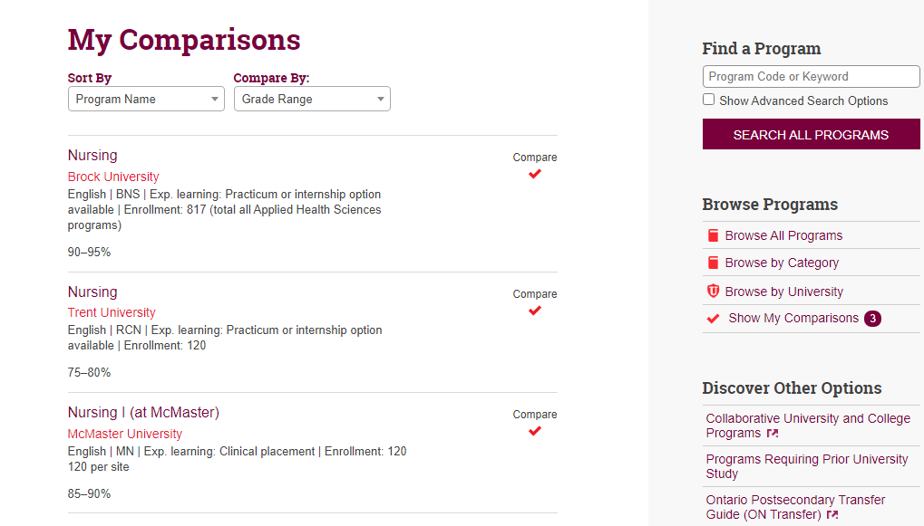
Finding University
Admission Average
https://www.ontariouniversitiesinfo.ca/programs/compare

Slide 57
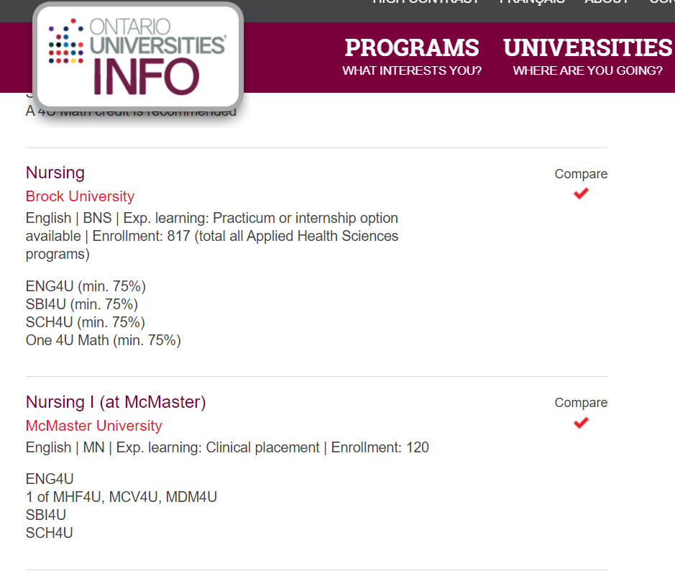
Finding University Program
Prerequisites

Slide 58
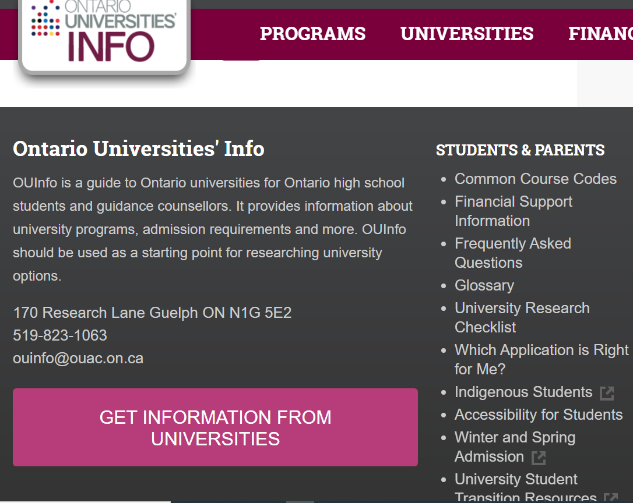
Parent Resources re: university
https://www.ontariouniversitiesinfo.ca/programs/search?search=business&a_category=&a_lang=22&submit=Search+All+Programs

Slide 59
Cost of University https://www.ontariouniversitiesinfo.ca/tuition-and-fees
www.ontariouniversitiesinfo.ca/tuition-and-fees

Slide 60
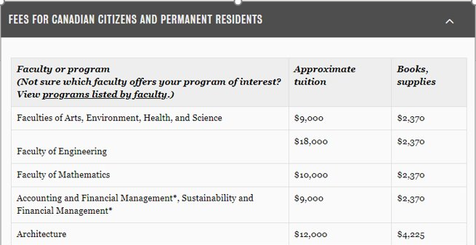
www.ontariouniversitiesinfo.ca/tuition-and-fees

Slide 61
Cost of University
https://uwaterloo.ca/future-students/financing/budget-calculator

Slide 62
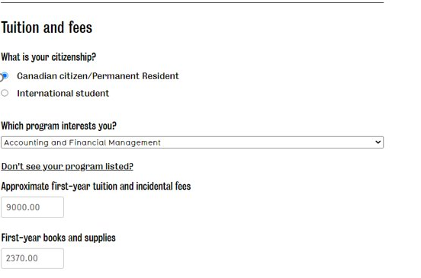
Cost of University
https

Slide 63
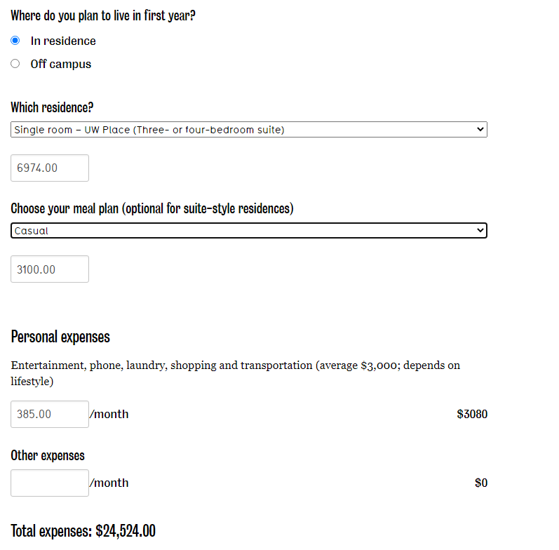
Cost of University
https://uwaterloo.ca/future-students/financing/budget-calculator

Slide 64
Suggested steps in high school
Take academic level courses (as long as successful)
Get good grades
Develop good homework and study habits
Follow your interests, develop your passion
Know prerequisites required
Get involved in extracurricular and leadership activities
VISIT SCHOOLS (virtually too) !!!!!!!!!
https://www.ontariouniversitiesinfo.ca/universities/events

Slide 65
Websites for researching Degree programs
– undergrad degree programs
- unergrad course calendars
– Collaborative Programs (college diploma & university degree)
University Pathway
www.ontariouniversitiesinfo.ca – undergrad degree programs
www.ontariocolleges.ca - undergrad degree programs
www.ouac.on.ca/university-links - undergrad course calendars
https://www.ouac.on.ca/guide/collaborative-university-college-programs/ – Collaborative Programs (college diploma & university degree)
www.ouac.on.ca – research graduate programs
*We strongly encourage campus visits Spring open houses or visiting during March break is a great idea.

Slide 66
Application Cost
www.ouac.on.ca
3 choices for $150
$50 for each extra choice
Deadline to apply is mid- January each year
Must confirm by June 1st

Slide 67
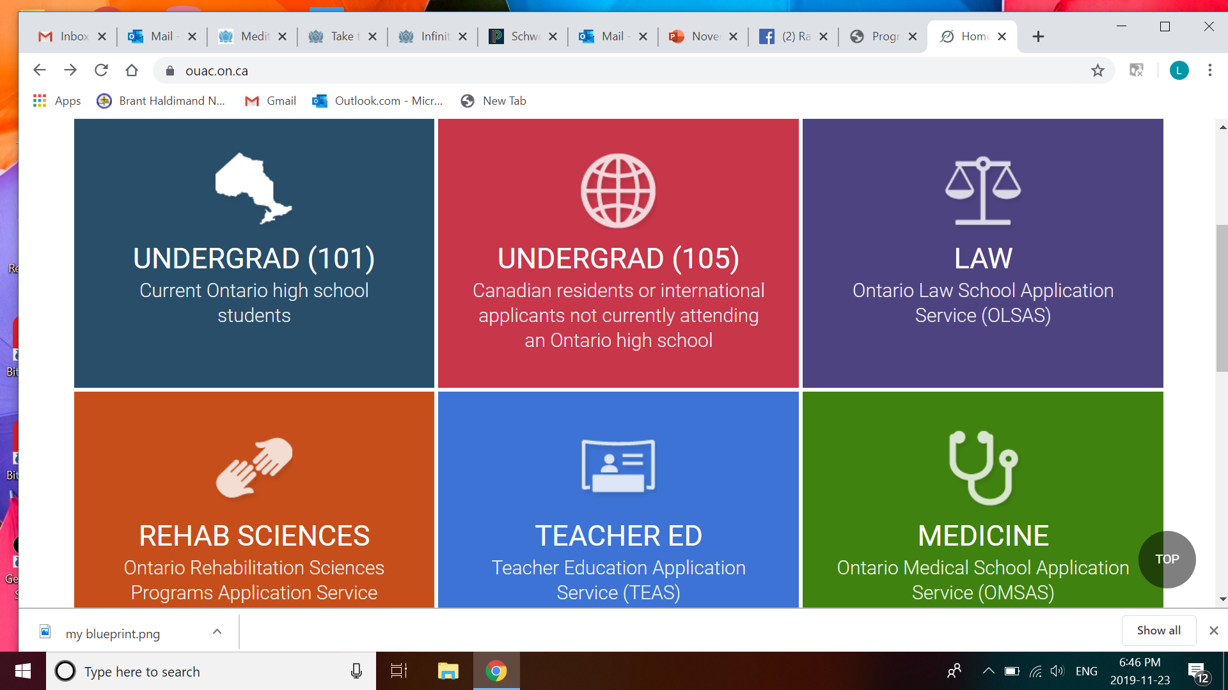
Professional Programs
https://www.ouac.on.ca/

Slide 68
WORKPLACE
Workplace planning board
https://workforceplanningboard.org/
Fanshawe career center
https://www.fanshawec.ca/student-life/campus-services/employment/community-career-and-employment-services
Norfolk Business
https://www.norfolkbusiness.ca/job-postings/
http://www.trinitycatholic.ca/guidance/important-websites-and-online-resources
Job bank
www.jobbank.gc.ca

Slide 69
WORKPLACE
Job search skills
https://core.myblueprint.ca/V5/Guide
Resume and cover letter
Interview skills
Network, network, network
Through part-time employment
Through coop

Slide 70
What if I don't know?
What did your child love to do as a child
What's easy for your child to do but others find difficult – that's a GIFT!
Take one step at a time – follow what resonates and which courses and careers excite your child
Explore program page of www.ontariocolleges.ca or www.ontariouniversitiesinfo.ca

Slide 71
What if I don’t know?
Research careers
Check the courses you'll study
Information interviews,
Take coop,
Job shadow,
Speak to students in program of interest
Do the surveys on My Blueprint that will match you to careers

Slide 72

My BLUEPRINT
Look for the blue M on your child's brightspace
Go under the tab – Who am I? There are various quizzes that your child can do to match their interests to careers.
Students can also explore career information on myblueprint.
Notes:
.

Slide 73
Who Do I Want to Be?
Encourage your child to choose a life that makes them feel alive, aligned with their values, interests, lifestyle and personality
Know yourself
Live from your strengths to develop your weaknesses
It's about the journey … not the destination

Slide 74
Questions????
Notes:
.

