Slide 1
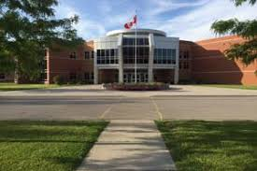
Making the transition to grade 12

Slide 2
Diploma requirements
What do I need to graduate?
Ontario
Secondary
School
Diploma

Slide 3
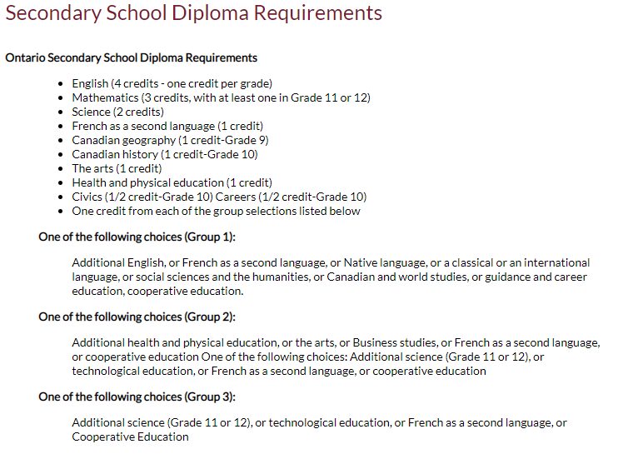
Diploma Requirements
Grade 11 Religion Counts!!

Slide 4
Diploma requirements
4 Religion Credits
8 Optional Credits
40 hrs Community Service
Successful completion of the Literacy Test or Literacy Course

Slide 5
LITERACY TEST UPDATE
Students who were unsuccessful on the test (completed last Fall) will meet with their Guidance Counsellor to discuss options for the Literacy course.
- In school
- Summer school

Slide 6
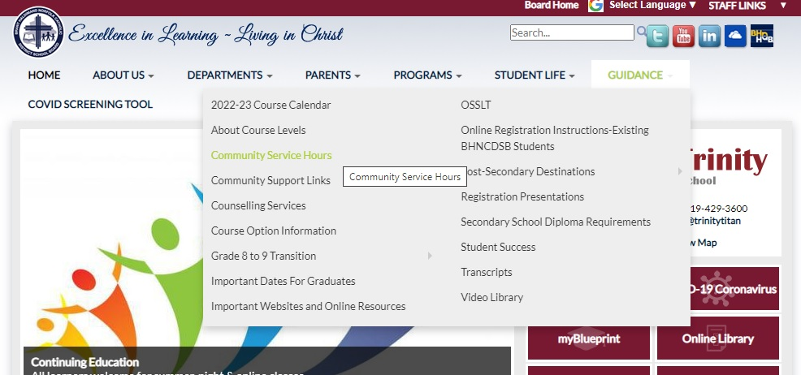
Community service

Slide 7
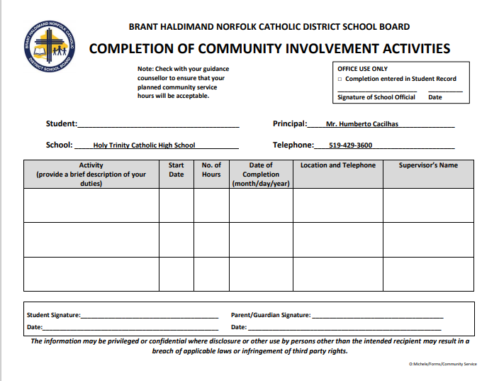

Slide 8
Making Compulsory choices
English
Religion
Minimum of 4 electives

Slide 9
ENGLISH
ENG4U – university
ENG4C – college
ENG4E – workplace
ENG4USS – university (summer school)
ENG4CSS – college (summer school)

Slide 10
RELIGION
HRE4M1 – Can be used for University Application
HRE4O1

Slide 11
Mathematics pathways
Make sure you have the appropriate pre-requisite for the Math course you need
Mathematics | Holy Trinity Catholic High School

Slide 12
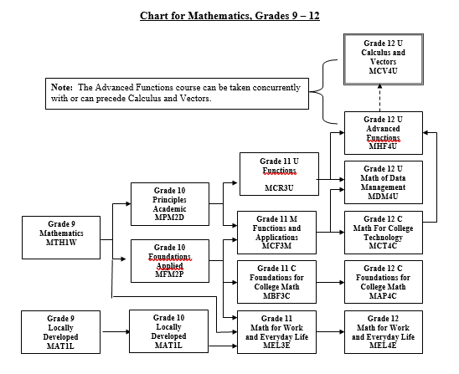

Slide 13
Planning for Post Secondary
Grade 11 Postsecondary Presentation – YouTube
A pre-recorded presentation on post-secondary destinations: college, university and apprenticeships

Slide 14
Plan Ahead – University Bound
Minimum of 6 grade 12 U/M courses required
Check pre-requisites & required average @
https://www.ontariouniversitiesinfo.ca/

Slide 15
Plan Ahead – Trades Bound
Check recommended courses and # of hours required
www.careersintrades.com
www.apprenticesearch.com

Slide 16
Plan ahead - trades
Math and Physics
Tech and Business
COOP / OYAP – credits + hours

Slide 17
Plan Ahead – College Bound
Check program prerequisites & minimum averages for competitive programs
Min 65% average for non-competitive programs
www.ontariocolleges.ca

Slide 18
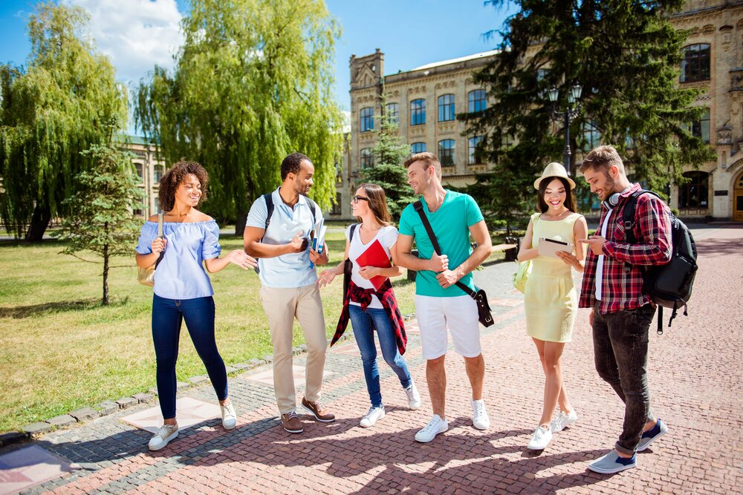
Campus visits
GO VISIT YOUR TOP 3 CHOICES OF SCHOOLS DURING SPRING OPEN HOUSES OR ON YOUR P.D. DAYS

Slide 19
How do I choose the right electives??
* Look carefully at online Course Guide and explore ALL possible choices. Note prerequisites
* You can also log into my blueprint to see course descriptions
* View the NEW slideshow with elective descriptions
Grade 12s are welcome to take gr 11 & gr 12 electives

Slide 20
Elective Courses
ARTS
Drama (M)
Music (Instrumental, Vocal & Repertoire) (M)
Guitar (O) - NEW
Visual Art (M)
Photography (M)
Portfolio Building (M)

Slide 21
Elective Courses
BUSINESS AND COMPUTER STUDIES
Computer Studies (U)
International Business (M)
Accounting (M)
Business Management (M)

Slide 22
Elective Courses
CANADIAN WORLD STUDIES
World Issues (U)
World History (U)
Economics (U)

Slide 23
Elective Courses
COOPERATIVE EDUCATION
Double Credit (O)
All Day Coop – choose twice

Slide 24
Elective Courses
MODERN LANGUAGES
French (U)
French – (O)
Extended French (U)

Slide 25
Elective Courses
ENGLISH
Writer’s Craft (U)
Media Studies (gr 11)
ESL (O)

Slide 26
Elective Courses
HEALTH AND PHYSICAL EDUCATION
Physical Education (O)
Personal Fitness (O)
Kinesiology (U)
Basketball (O)

Slide 27
Elective Courses
SCIENCE
Biology (U)
Chemistry (U or C)
Physics (U or C)
Health Science (M)
Health Care (C or E)

Slide 28
Elective Courses
SOCIAL SCIENCES & HUMANITIES
Challenge and Change in Society (U)
Philosophy (U)
Personal Life Management (O)

Slide 29
Elective Courses
INTERDISCIPLINARY STUDIES
Peer Tutoring (U) – application required
Grade 11 Law and Economics (E)

Slide 30
Elective Courses
TECHNOLOGY
Communications (M)
Computer Engineering (M)
Construction (C)
Tech Design (M)
Architectural Design (M)
Transportation (C)

Slide 31
Elective Courses
TECHNOLOGY
Transportation (C)
Double credit: NEW ½ day Transportation and Welding

Slide 32
Elective Courses
TECHNOLOGY
Barbering (Gr 11)
Hairstyling & Aesthetics (E)
Cooking (E) single or double credit: Chef Training
Baking (E) single or double credit

Slide 33
Summer School 2021
If summer school is part of your plan…take this into account when choosing courses.
You should choose your summer school courses BEFORE completing your grade 12 registration.
MyBlueprint - Continuing Education tab

Slide 34
GRADE 12 SUMMER SCHOOL CHOICES
ENG4C – English College
ENG4U – English University
EWC4U - Writer’s Craft
HIP4O1 – Personal Life Mgmt
GLN4O – Navigating the workplace
OLC4O – Literacy Course
MCT4C – Math for College Technology
Credit recovery

Slide 35
GRADE 11 Summer school choices
HRT3M –Religion
HRF3O –Religion
PPZ3C – Health for Life
SVN3E – Environ. Science
GPP3O – Leadership
MCF3M – Mixed Math
EMS3O – Media Studies
SBI3C – Biology NEW
HSE3M – Social Justice NEW
DCO3O2 – COOP
Credit Recovery

Slide 36
Shsm – Specialist High Skills Major
Customize your education to suit your interests and career plan
Learn sector specific skills and knowledge
Gain valuable work experience by completing a two-credit coop in your field
Acquire certifications that are specific to your field

Slide 37
Shsm – specialist high skills major
Agriculture (Green Industries)
Health and Wellness
Hospitality and Tourism
Transportation
Sport
CHARTS – Click Here!

Slide 38
Due dates
Courses are first come, first served. Don’t miss the deadline!
Collecting on Feb. 22nd & 23rd in homerooms.
Sign Off Forms with parent signature & $35 Activity Fee

Slide 39
How do I register?
Log In
Log into MyBlueprint to make grade 12 course selections.
Choose
Choose summer school option first (IF applicable)
Pick
Make all course selections
Remember
Once you hit submit, course selections will be locked in!

Slide 40
ALTERNATE CHOICE
Each student will need to add an ALTERNATE (elective) CHOICE
Choose a BACKUP Option that you would be happy with

Slide 41
Choose wisely
REMEMBER…
It is your future, and it is important to consider all post-secondary options

Slide 42
QUESTIONS /HELP
Your Surname​ | Counsellor Contact​
A – Ha | caitken@bhncdsb.ca​
He – Pi​ | cdeconinck@bhncdsb.ca ​
Po - Z​ | rderoo@bhncdsb.ca ​

