Slide 1
Registration Info
Getting from HERE to THERE!
Notes:
Hello everyone. It is Ms. Deconinck O'Neail from guidance here to share with you our grade 9 registration presentation. Please note that a slideshow of this presentation will be available to view from our website trinitycatholic.ca, found under the guidance tab in registration information.

Slide 2
Making the Transition to Grade 10
Notes:
Making the transition from grade 9 to grade 10 ☺

Slide 3
Diploma Requirements
Ontario
Secondary
School
Diploma
Secondary School Diploma Requirements | Holy Trinity Catholic High School
Notes:
The goal of every high school student is to graduate with an OSSD (Ontario secondary school diploma) or an OSSC (Ontario secondary school certificate).
This link will take you directly to our trinitycatholic webpage where both OSSD and OSSC requirements are outlined.
As we go through the required courses please check off the courses that you have already taken by filling in the box on the handout, if you are currently taking the course half fill the box so you can keep track of your required courses

Slide 4
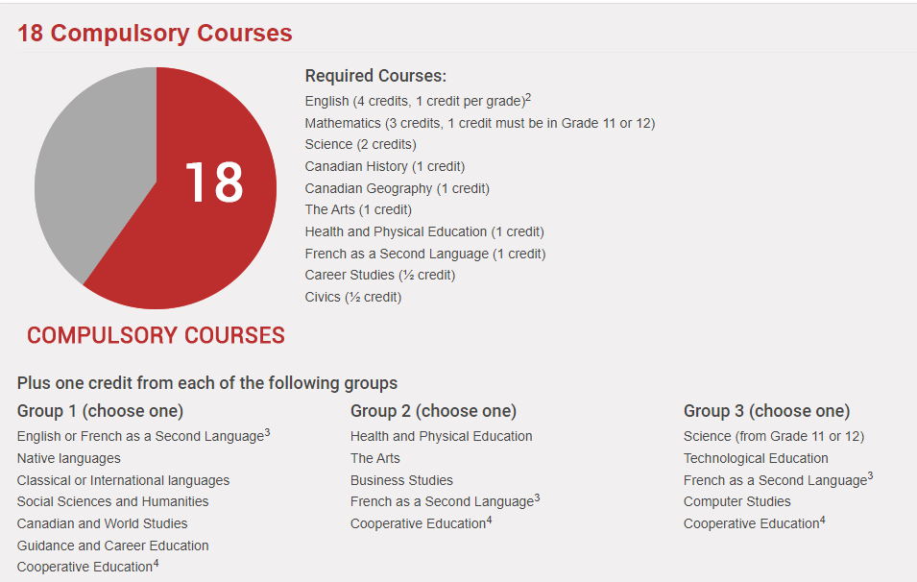
Diploma Requirements
Covered by gr. 11 religion
Notes:
Catholic Secondary School Diploma Requirements include 4 things
1. 30 credits, 18 of which are compulsory ( will come back and explain these)
2. As well as religion credits, a literacy component and community hours which I will explain in the next slide
I will take a moment to go over the 18 compulsory credits here at the top – as we do this you can mark off the ones you have already taken on the back of the instructions sheet
You are required to take an English course at each of the 4 grade levels.
You are required to complete 3 math credits, at least one of which at the grade 11 or 12 level
You also need a min of 2 science credits as well as 1 credit in French
Each student is required to have
1 grade 9 geography credit
1 grade 10 history credit
1 arts and 1 physed credit
As well as your careers and civics half-credit courses
In addition to these basic requirements, there are 3 more groups that need to be satisfied.
The GROUP ONE requirement will be met once you complete your grade 11 religion credit
For your Group TWO you will need to complete an additional credit in Gym or Art or French
OR complete a business or coop credit
For you GROUP 3 requirement you will need to pass one of the following:
A grade 11/12 science credit
A tech credit
A second French credit
A computer studies or a coop credit
That my friends wraps up the compulsory courses for an OSSD
Now back to the slideshow

Slide 5
Notes:
Other graduation requirements include:
Completing 12 more optional courses (including your grade 9, 10 and 12 religion classes)
40 hours of community service
And successful completion of either the grade 10 literacy test or the grade 12 literacy course.

Slide 6
Literacy Test – March/April of your gr. 10 year
If you do not pass the literacy test:
Another chance to write test will be given
OR you could take the literacy course
Student must pass the test OR course to graduate
Ontario
Secondary
School
Diploma
Notes:
Literacy Test –
You will be scheduled to write your grade 10 Literacy test in the spring of grade 10.
If you are unsuccessful in your first attempt, you will either re-write the test in grade 11, or complete the literacy course in summer school or grade 11 or 12.

Slide 7
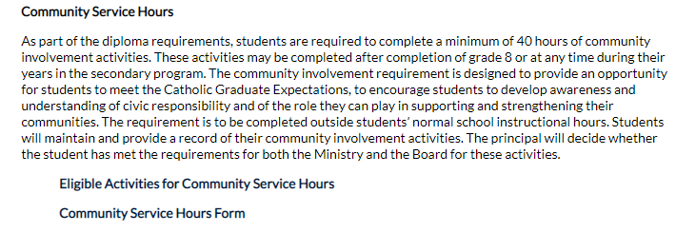
Notes:
Community Service Hours
Each student is required to complete 40 community service hours. We strongly encourage you to aim to complete your hours before September of your grade 12 year.
You can access this form from trinitycatholic.ca under the guidance tab, under community service hours. Hours must be completed with a not for profit organization, they cannot be a job that someone would usually get paid for. If you are unsure if hours would qualify ask your guidance counsellor. For a list of eligible activities you can click on the first link,
For a community service hours form to complete, please click on the second link

Slide 8
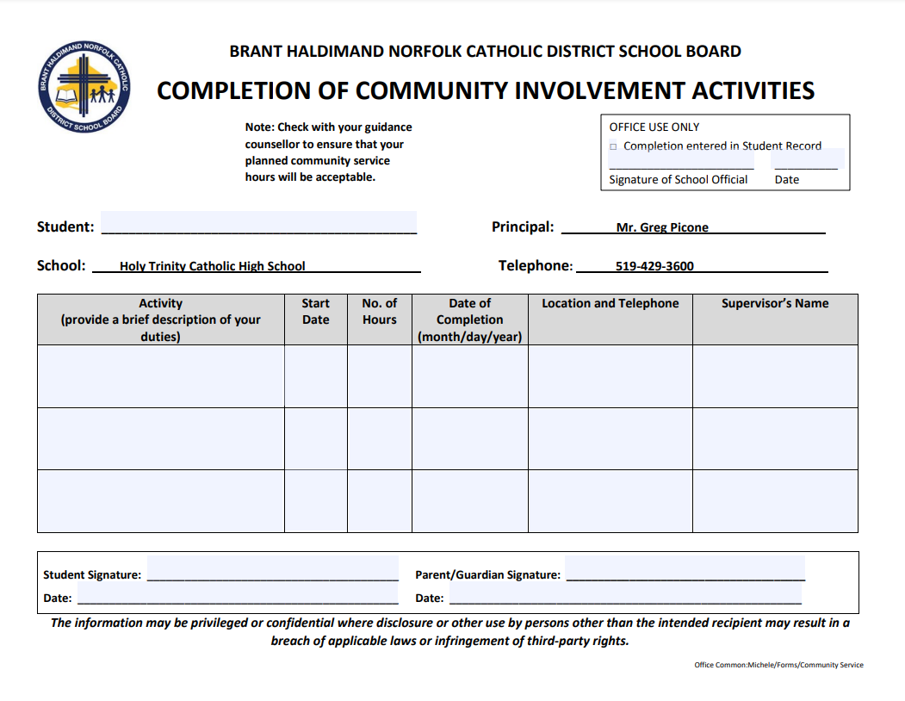
Notes:
Here is the form you will complete and submit to record your hours. These forms can be picked up and dropped off in guidance.

Slide 9
Making Choices for Compulsory Credits
Notes:
There are 6 compulsory credits in your grade 10 year. CLICK

Slide 10
Grade 10 Religion
HRE2O1 - Open
Notes:
The first is your religion credit, at the open level

Slide 11
Grade 10 Careers/Civics
GLC2OH/CHV2OH – Open
GLC2OSS/CHV2OSS - Summer school
Notes:
Next we have your Careers/Civics credits which can be taken in school, or as a summer school credit. There will be more details about summer school in later slides.

Slide 12
Grade 10 English
ENG2P1 - Applied
ENG2D1 - Academic
ENG2L1 – Locally Developed
Notes:
For your English credit you have 3 levels to choose from, the applied, academic and locally developed. Please note that I will discuss the potential to change levels in an upcoming slide

Slide 13
Grade 10 Science
SNC2P1 - Applied
SNC2D1 - Academic
SNC2L1 – Locally Developed
Notes:
For your Science credit you have 3 levels to choose from, the applied, academic and locally developed.

Slide 14
Grade 10 History
CHC2D1 – Academic
CHC2P1 - Applied
CHC2L1 – Locally Developed
CHC2DF – French instruction
Notes:
For your History credit you have 3 levels to choose from, the applied, academic and locally developed.
If you are in our extended French program, you would have completed your geography in your grade 9 year, so for grade 10 you are to choose your grade 10 history credit . There is a later slide to explain the progression of study for our extended French students.

Slide 15
Grade 10 Math
MFM2P1 - Applied
MPM2D1- Academic
MAT2L1 – Locally Developed
Notes:
For your Math credit you have 3 levels to choose from, the applied, academic and locally developed.

Slide 16
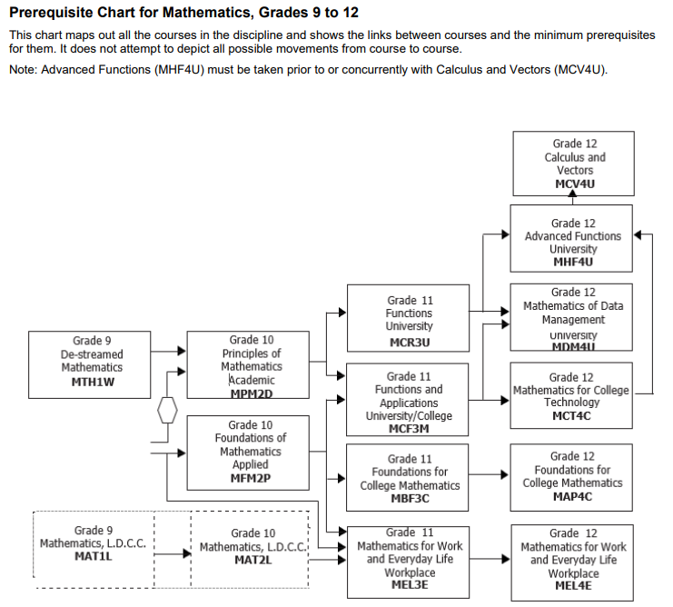
Notes:
Here is a MATH chart for your reference. Please note that your grade 9 math was likely completed at the destreamed level. From the grade 9 destreamed math course, you can enter grade 10 academic, applied or locally developed. IF your intentions are to move to the academic stream, the recommendation from our math department would be to have at least an 80% in the destreamed grade 9 course. If you finished somewhere between a 60-80 then applied is probably the appropriate level for you. If you really struggled talk to your teacher or guidance counsellor and perhaps the locally developed grade 10 level would be a better fit for you.
Please note on the next slide I have added a link to this chart on our website

Slide 17
Mathematics | Holy Trinity Catholic High School

Slide 18
How do I choose the right level??
Evaluate your success and effort in Grade 9
A mark of 70% is recommended for continued work at your current level of study, as well as good work habits & organizational skills
Begin researching various destinations to find out what education is required to achieve your goal
Notes:
How do I choose the right level?
It is very important to evaluate both your success and your effort in grade 9.
We recommend a mark of at least 70% if you want to continue with classes at your current level of study. This means that if you are studying at the applied level in grade 9, we would recommend a final grade of 70% to continue studying at the applied level. For the destreamed math to move into the academic level we recommend an 80 or above in the destreamed math, or perhaps a 75% with excellent work habits.
It is also time to start considering what you might be interested in doing post-secondary, after high school. If you have questions please see your guidance counsellor.

Slide 19
Changing levels
Students will be able to move from APPLIED courses in grade 9 to ACADEMIC courses in grade 10. We would only recommend this change if students have done very well at the applied level and have demonstrated good work skills.
Students will be able to move from ACADEMIC courses in grade 9 to APPLIED courses in grade 10.
Notes:
As I have previously mentioned, if you would like to change levels in grade 10, it is not a problem. If you achieved a very good mark and had a good understanding of the content in your grade 9 applied English and/or Science class, and would like to move to the academic level, you can simply sign up for the grade 10 academic class.

Slide 20
PLAN AHEAD
Some grade 10 courses will be prerequisites for specific grade 11 courses
SBI3U requires SNC2D
AWQ3O requires AVI1O1/2O1
Grade 10 students interested in Science/Math will sometimes jump ahead and add a grade 11 class to their grade 10 year.
Notes:
Planning ahead
Choosing courses for grade 9 was pretty simple, you had to decide on a level, and then pick 2 elective classes. Grade 10 is similar, in that you have 2 elective classes to choose from, but slightly more important, as you have to consider that some grade 11 courses are going to require specific grade 9 or 10 courses as prerequisites.
For example, if you want to take Photogrpahy in grade 11, you need a grade 9 or 10 art credit.

Slide 21
Extended FRENCH program
Reminder to select FEF2D1
2022-2023 (gr 10) – History CHC 2DF(French instruction)
2024-2025 (gr 11) - World Religions HRT3MF (French instruction)
Geography CGC1 DF (French instruction) – you completed in 2021/22
Notes:
For those of you enrolled in our Extended French Program, please remember to choose FEF2D1 as one of your elective courses. As I mentioned earlier, you are currently enrolled in the grade 9 Geography course, so for next year you are to choose the grade 10 history course, which will be delivered in French. You can take your grade 10 religion this year, and we will offer the grade 11 world religions in French again for your grade 12 year.

Slide 22
Summer School offerings
It is very important to plan for summer school now so you can pick next years courses effectively
Please click link below to see summer course offerings
myBlueprint
Notes:
This summer BHN will be offering a number of summer school courses at each of the 4 grade levels. You will register for summer school using my blueprint.

Slide 23
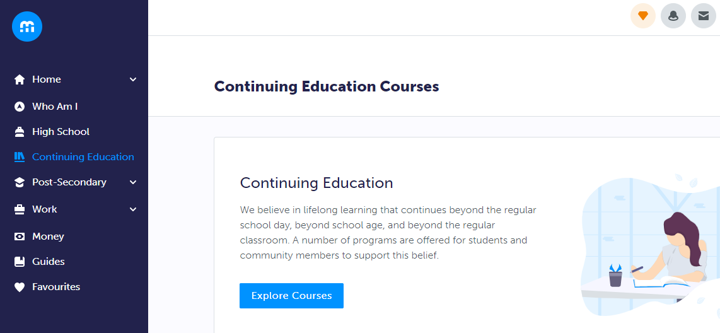
Notes:
Here is a quick visual of how to register for summer school, but know that Ms. Aitken will have a short HOW TO video at the end of this presentation. Once here, click on the CONTINUING EDUCATION tab on the left, and then click the blue explore courses tab

Slide 24
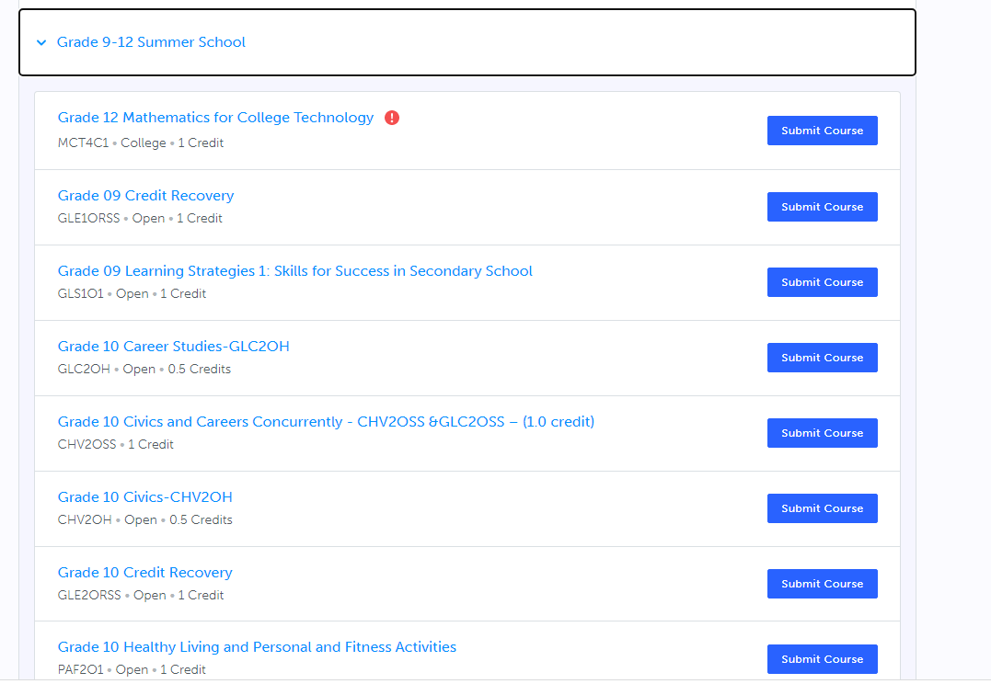
Notes:
This will take you to the Summer school page, When you click on the gr. 9-12 summer school tab you will see the available courses.

Slide 25
Summer School Grade 10 courses
CHV/GLC – Careers/Civics
ICS2O – Computer Science
PAF20 – Personal Fitness
Credit Recovery
Notes:
Grade 10 summer school offerings include
Careers and Civics
Computer Science
Personal Fitness and
Credit recovery

Slide 26
Summer School Grade 9 courses
BTT1O1
GLS1O1
AWL101 – drawing
Notes:
You are also able to register for grade 9 or grade 11 summer courses.
Grade 9 course offerings include:
Introduction to Business Technology
Learning Strategies
An arts credit in Drawing

Slide 27
Summer School Grade 11 courses
HRT3M –Religion
HRF3O –Religion
PPZ3C – Health for Life
SVN3E – Environ. Science
GPP3O – Leadership
MCF3M – Mixed Math
EMS3O – Media Studies NEW
SBI3C – Biology NEW
DCO3O2 – COOP
Credit Recovery
Notes:
Grade 11 options include:
Religion, health for life, environmental science, leadership, mixed math, media studies, coop and credit recovery.
If you are considering reaching ahead with a grade 11 summer school class, please ensure that you have the pre-requisite to the course. IE: Grade 10 math is a pre-requisite to grade 11 Mixed math.

Slide 28
Summer School Dates
Notes:
If you would like help in choosing a summer school course, please email your guidance counsellor for an appointment.
Summer school runs from July 4 – July 28th, 2022. The deadline to register is June 17, however if you are choosing a compulsory class, you will need to complete the summer school registration prior to submitting your grade 10 course selections.

Slide 29
Making Choices for Elective Credits

Slide 30
How do I choose the right electives??
Look carefully at online Course Guide and explore ALL possible choices. Note prerequisites
Or look at trinitycatholic.ca and under the guidance tab and watch the video of the teacher course description of each elective powerpoint
Explore new skills and interests
Talk to parents & teachers & friends.
Research – jobs, enrichment opportunities, school and programs
Notes:
How do I choose the right electives ?
Read bullet #1 – please note that HT information starts on page 27
We also encourage you to … read rest of bulletts

Slide 31
ELECTIVE CHOICES The Arts
Music Vocal
Music Instrumental
Guitar (prerequisite is gr. 9 instrumental music)
Drama
Visual Arts
Notes:
The following 5 slides outline the elective courses available for you to choose. There are many choices, please take the time explore the options.
Elective courses in the arts

Slide 32
ELECTIVE CHOICES Business & Guidance
Intro to Business/Information Technology
Learning Strategies
Computer Science
Notes:
Elective courses in business include and guidance include

Slide 33
ELECTIVE CHOICES English & Languages
French (D or P)
Extended French (D)
ESL (English as a Second Language)
Media Studies (gr. 11) (prerequisite gr. 10 english

Slide 34
ELECTIVE CHOICES Physical Education
Health and Physical Education – Co-ed
Personal Fitness
Hockey (grade 9)
Volleyball (Coed) (grade 10)
Notes:
Elective choices in gym include:
If you haven’t taken hockey in grade 9, you can take in grade 10 for a credit

Slide 35
ELECTIVE CHOICES - TECH
Barber (gr 11) - NEW
Communications
Computer Engineering
Construction
Cooking (Hospitality)
Hairstyling
Tech Design
Transportation
Notes:
Tech choices include:
The new Barbering class is being offered at the grade 11 level. If you are interested in this class please sign up, but understand if it is full of senior students, you may have to wait until grade 11 to take it.

Slide 36
Alternate Choice
We are requiring students to make an ALTERNATE (elective) CHOICE
Choose a BACKUP Option that you would be happy with if one of your choices does not run, or if there is a conflict.
Notes:
Like last year each student will be required to put an ALTERNATE elective selection on their registration. Please choose your alternate wisely, as this course will be added to your schedule in the event that one of your first choice electives is not possible.

Slide 37
HOW TO REGISTER
Register through my blueprint myBlueprint
myBlueprint Registration instructions
** Due date: Feb 22, 2022
** In order to save a spot in the classes you want for grade 11, you must SUBMIT your course selections by the due date: Feb 22, 2021
Notes:
You will be using my blueprint to register for your grade 10 courses. This is the same program you used last year when registering for grade 9. Please note that I have included links to the myblueprint website, as well as a link to instructions on how to use my blueprint.
Please note the due date is Feb 23. In order to get the classes you want, you must submit your selections by Feb 23.
After this presentation Ms. Aitken will be showing a short HOW TO video, reminding you how to use my blueprint.

Slide 38
REMEMBER…
Course Request Sign-Off Form due Feb 22nd with your $35 activity fee.
A parent signature is required.
Once you hit SUBMIT, courses are locked in!
Notes:
Now lets quickly walk through how to register.

Slide 39
Questions? Need Guidance?
Your Surname | Counsellor Contact
A – Ha | caitken@bhncdsb.ca
He – Pi | cdeconinck@bhncdsb.ca
Po - Z | rderoo@bhncdsb.ca
Notes:
Please, if you have any questions about course selections for grade 10, do not hesitate to reach out to your guidance counsellor. Our email addresses are provided here.

