Slide 1
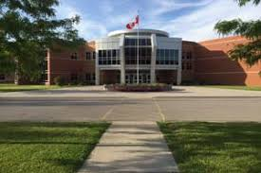
Making the transition to grade 12

Slide 2
Diploma requirements
What do I need to graduate?
Ontario
Secondary
School
Diploma

Slide 3
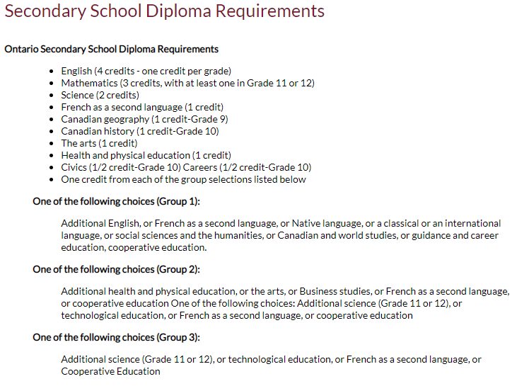
Diploma Requirements
Grade 11 Religion Counts!!

Slide 4
Diploma requirements
4 Religion Credits
8 Optional Credits
40 hrs Community Service
Successful completion of the Literacy Test or Literacy Course

Slide 5
Diploma requirements
2 ONLINE LEARNING CREDITS
A requirement beginning with students who entered Grade 9 in the 2020-21 school year – current grade 11s – unless you have OPTED OUT
“Opt Out Form” now available through MyBlueprint

Slide 6
Community Service Hrs
MUST BE NON-PROFIT ORGANIZATIONS/ AGENCIES/ EVENTS
Churches, hospitals, minor sports associations, Lions Club, Pumpkinfest, etc.
NOT dance academies, farmwork, businesses, horse stables, etc.
Notes:
The last slide showed the 18 compulsory credits
After that you require 3 more religion credits, and 8 optional credits.
you need 40 hours of community service, as well as successful completion of the literacy test or course.

Slide 7
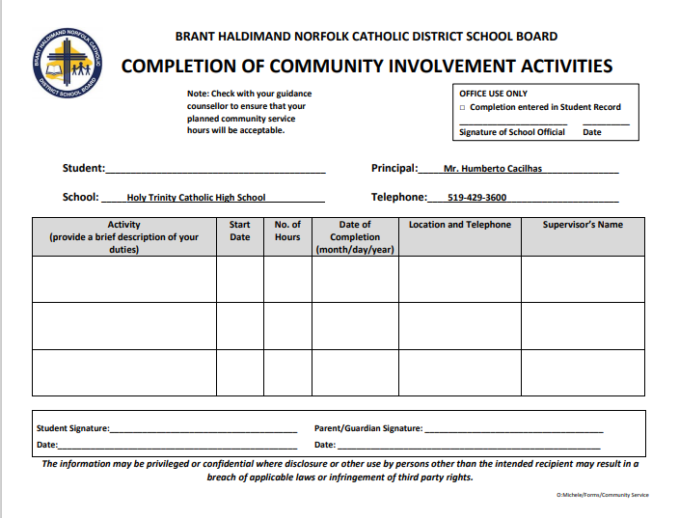

Slide 8
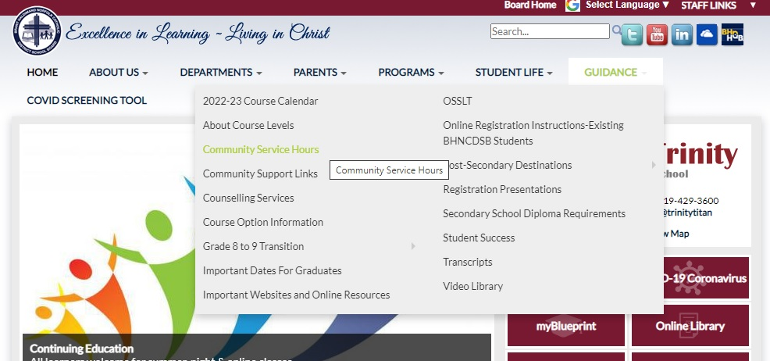
Community service

Slide 9
Picking courses for Grade 12
Notes:
Picking courses for grade 11 is very different than grade 9 and 10 ….
For one – you will have 5 electives to choose from, rather than just 2
For two – grade 11 courses lead directly to grade 12 courses, which are often pre-requisites for specific college/university programs
For three– the language changes

Slide 10
Making Compulsory choices
English
Religion
Minimum of 4 electives

Slide 11
ENGLISH
ENG4U – university
ENG4C – college
ENG4E – workplace
ENG4USS – university (summer school)
ENG4CSS – college (summer school)

Slide 12
RELIGION
HRE4M1 – Can be used for University Application
HRE4O1

Slide 13
Mathematics pathways
Make sure you have the appropriate pre-requisite for the Math course you need
Mathematics | Holy Trinity Catholic High School

Slide 14
MATH
MDM4U1 – Data Management
MHF4U1 – Adv. Functions
MCV4U1 – Calculus/ Vectors
MEL4E1 – Work/ Everyday Life
MAP4C1 – College Math
MCT4CE – College Tech (online)
Notes:
Picking the appropriate level of math for grade 11 is VERY important. You have to look back and ahead to make the correct choice. Looking ahead - Which level of math is required for the post-secondary options you are exploring .. Looking back – how did you do in your grade 10 math course.

Slide 15
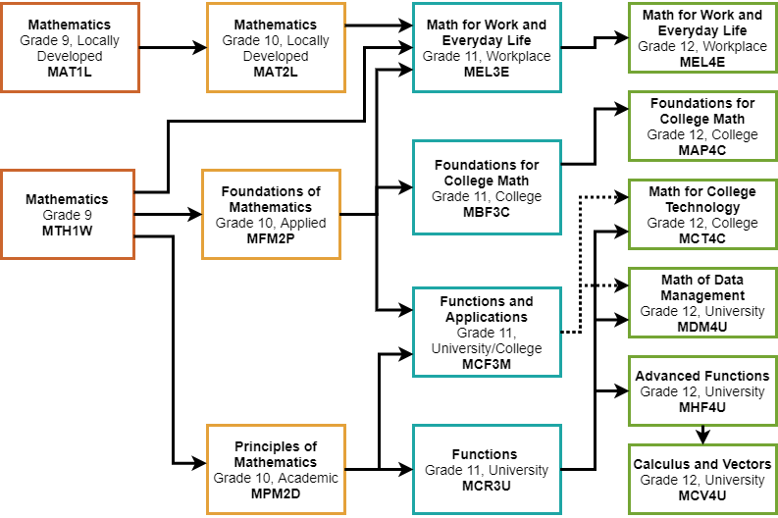

Slide 16
Shsm – Specialist High Skills Major
Customize your education to suit your interests and career plan
Learn sector specific skills and knowledge
Gain valuable work experience by completing a two-credit coop in your field
Acquire certifications that are specific to your field

Slide 17
Planning Ahead
SHSM Candidates:
There are required courses you need to complete your SHSM. Be sure to add required courses, as well as a ½ day coop to your course planning.

Slide 18
HT SHSMs
SHSM Offerings:
Agriculture
Construction
Health and Wellness
Hospitality and Tourism
Sport
Transportation

Slide 19
Planning for Post Secondary
Grade 11 Postsecondary Presentation – YouTube
A pre-recorded presentation on post-secondary destinations: college, university and apprenticeships

Slide 20
Plan Ahead – University Bound
Minimum of 6 grade 12 U/M courses required
Check pre-requisites & required average @
https://www.ontariouniversitiesinfo.ca/

Slide 21
Plan Ahead – Trades Bound
Check recommended courses and # of hours required
www.careersintrades.com
www.apprenticesearch.com
https://oyapskilledtrades.ca/

Slide 22
Plan ahead - trades
Math and Physics
Tech and Business
COOP / OYAP – credits + hours

Slide 23
Plan Ahead – College Bound
Check program prerequisites & minimum averages for competitive programs
Min 65% average for non-competitive programs
www.ontariocolleges.ca

Slide 24
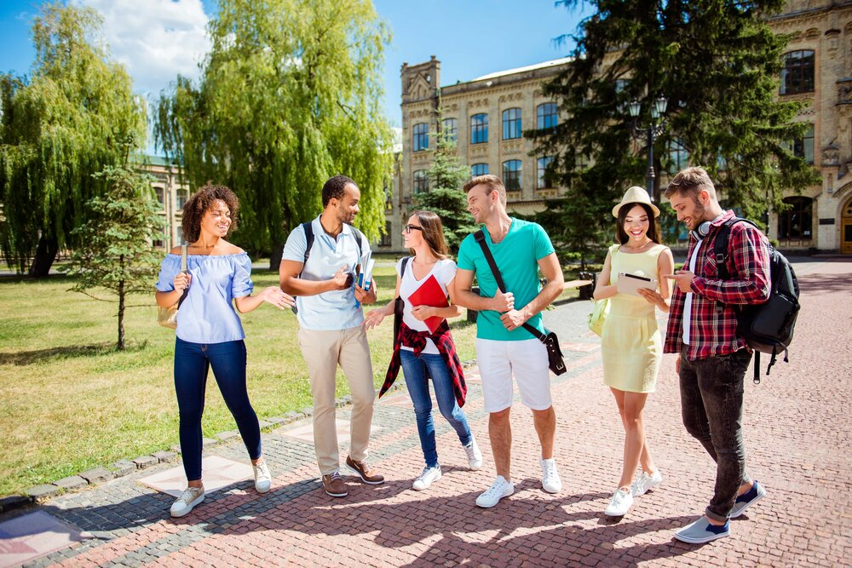
Campus visits
GO VISIT YOUR TOP 3 CHOICES OF SCHOOLS DURING SPRING OPEN HOUSES OR ON YOUR P.D. DAYS

Slide 25
How do I choose the right electives??
* Look carefully at online Course Guide and explore ALL possible choices. Note prerequisites
* You can also log into my blueprint to see course descriptions
* View the slideshow with elective descriptions
Grade 12s are welcome to take gr 11 & gr 12 electives

Slide 26
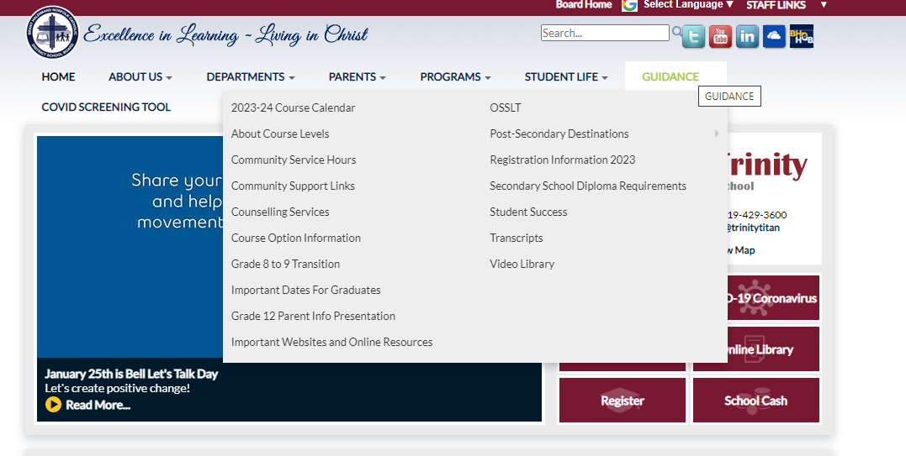
HOW DO I CHOOSE THE RIGHT ELECTIVES??
Notes:
I will quickly go through the elective choices you have for grade 11, but know that this information is found on our course guide which is linked here. Please open this link and go to page 27 to find Holy Trinity course offerings. You will also find our course offerings on MY blueprint once you log in. Please note that grade 11 students can choose grade 11 and grade 12 electives.

Slide 27
Elective Courses
ARTS
Drama (M)
Music (Instrumental, Vocal & Repertoire) (M)
Guitar (O)
Visual Art (M)
Photography (M)
Portfolio Building (M)

Slide 28
Elective Courses
BUSINESS AND COMPUTER STUDIES
Computer Studies (U)
International Business (M)
Accounting (M)
Business Management (M)

Slide 29
Elective Courses
CANADIAN WORLD STUDIES
World Issues (U)
World History (U)
Economics (U)

Slide 30
Elective Courses
COOPERATIVE EDUCATION
Double Credit (O)
All Day Coop – choose twice

Slide 31
Elective Courses
MODERN LANGUAGES
French (U)
French – (O)
Extended French (U)

Slide 32
Elective Courses
ENGLISH
Writer’s Craft (U)
Media Studies (gr 11)
ESL (O)

Slide 33
Elective Courses
HEALTH AND PHYSICAL EDUCATION
Physical Education (O)
Personal Fitness (O)
Kinesiology (U)
Basketball (O)

Slide 34
Elective Courses
SCIENCE
Biology (U)
Chemistry (U or C)
Physics (U or C)
Health Science (M)
Health Care (C or E)
Environmental Science (gr. 11/ E level)

Slide 35
Elective Courses
SOCIAL SCIENCES & HUMANITIES
Families in Canada (U)
Philosophy (U)
Personal Life Management (O)

Slide 36
Elective Courses
INTERDISCIPLINARY STUDIES
Peer Tutoring (U) – application required
Grade 11 Law and Economics (E)

Slide 37
Elective Courses
TECHNOLOGY
Communications (M)
Computer Engineering (M)
Tech Design (M)
Architectural Design (M)
Gr. 11 Robotics/ Control Systems NEW!

Slide 38
Elective Courses
TECHNOLOGY
Transportation (C)
Double credit: ½ day Transportation and Welding

Slide 39
Elective Courses
TECHNOLOGY
Hairstyling & Aesthetics (E)
Cooking (E) single or double credit: Chef Training
Baking (E) single or double credit

Slide 40
E-Learning
CLN4CE – Legal Studies
NBE3CE – Understanding Contemporary First Nations, Metis, and Inuit Voices (Sub for grade 11 College English)
NBE3UE - Understanding Contemporary First Nations, Metis, and Inuit Voices (Sub for grade 11 U English)​
Notes:
DUE DATES - In order to save a spot in the classes you want for grade 11, you must SUBMIT your course selections by the due date – Feb 22.

Slide 41
E-Learning
PPZ3CE – Health For Life
SVN3ME – Environmental Science
Understanding Contemporary First Nations, Metis, and Inuit Voices (Sub for grade 11 U English)​
Notes:
DUE DATES - In order to save a spot in the classes you want for grade 11, you must SUBMIT your course selections by the due date – Feb 22.

Slide 42
Summer School 2023
If summer school is part of your plan…take this into account when choosing courses.
You should choose your summer school courses BEFORE completing your grade 12 registration.

Slide 43
Summer School 2023
All summer school courses are e-learning and asynchronous
July 4th- 28th
Daily attendance required
MyBlueprint - Continuing Education tab

Slide 44
Grade 11 summer school choices
HRT3M – World Religions
HRF3O – World Religions
PPZ3C – Health for Life

Slide 45
GRADE 11 Summer school choices
MCF3M – Mixed Math
NBE3U – Understanding Contemporary First Nations, Metis, and Inuit Voices (Sub for grade 11 U English)
DCO3O2 – COOP
Credit Recovery

Slide 46
GRADE 12 SUMMER SCHOOL CHOICES
ENG4C – English College
ENG4U – English University
EWC4U - Writer’s Craft
MDM4U – Data Management
MAP4C– College Mathematics
OLC4O – Literacy Course
Notes:
Here are the grade 12 courses offered in summer school

Slide 47
Due dates
Courses are first come, first served. Don’t miss the deadline!
Collecting on Feb. 27th & 28th in homerooms.
Sign Off Forms with parent signature & proof of payment – School Cash online - $35 Activity Fee
Notes:
DUE DATES - In order to save a spot in the classes you want for grade 11, you must SUBMIT your course selections by the due date – Feb 22.

Slide 48
How do I register?
Log In
Log into MyBlueprint to make grade 12 course selections.
Choose
Choose summer school option first (IF applicable)
Pick
Make all course selections
Remember
Once you hit submit, course selections will be locked in!

Slide 49
ALTERNATE CHOICE
Each student will need to add an ALTERNATE (elective) CHOICE
Choose a BACKUP Option that you would be happy with

Slide 50
Choose wisely
REMEMBER…
It is your future, and it is important to consider all post-secondary options

Slide 51
QUESTIONS /HELP
Your Surname​ | Counsellor Contact​
A – G | caitken@bhncdsb.ca​
H – Pa​ | cdeconinck@bhncdsb.ca ​
Pe - Z​ | rderoo@bhncdsb.ca ​
Notes:
That concludes the powerpoint part of my presentation for today.
If you have any questions, or require assistance please email your guidance counsellor to set up an appointment.

Slide 52
How do I register?
MyBLUEPRINT
myBlueprint
Notes:
Now I will take you to our school website .. To show you how to find this presentation, as well as to remind you how to use MY BLUEPRINT to sign up!

