Slide 1
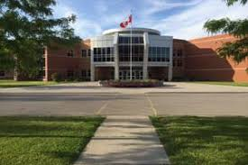
Returning grade 12s

Slide 2
Why do you want to return?
GOOD / VALID REASONS TO RETURN
Complete required courses for post-secondary program
Test-drive a career – COOP/ OYAP (1/2 day or full day)
Upgrade marks for post-secondary
Finish portfolio or other admission requirements
Try new courses for potential new career path

Slide 3
Why do you want to return?
BAD REASONS TO RETURN
To play sports
Have no other plan or researched options
To repeat the same courses = and expect different results
To be with friends

Slide 4
Gap year options
Work to gain $$, experience, skills, connections
Volunteer, travel
Do part-time study or complete high school courses online ($40/ course)
Do more research of post-secondary options
Notes:
The last slide showed the 18 compulsory credits
After that you require 3 more religion credits, and 8 optional credits.
you need 40 hours of community service, as well as successful completion of the literacy test or course.

Slide 5
Undecided??
It is okay to be undecided, as long you have a plan
If there is a CHANCE you might return to HT for a 5th year, be sure to register with us by the due date: Feb 27th .
If there is a CHANCE you might go to college, be sure to log in now and see if programs are open.
If there is a CHANCE you are going to work full time, start your job search now.
Notes:
Read slide

Slide 6
Student activity fee
3 – 4 classes - $25
Up to 8 classes - $35
Payment must be completed on school cash online
No minimum # of classes: come back for only what you need

Slide 7
Plan Ahead – University Bound
Minimum of 6 grade 12 U/M courses required
Check pre-requisites & required average @
https://www.ontariouniversitiesinfo.ca/

Slide 8
Plan Ahead – Trades Bound
Check recommended courses and # of hours required
www.careersintrades.com
www.apprenticesearch.com

Slide 9
Plan ahead - trades
Math and Physics
Tech and Business
COOP / OYAP – credits + hours

Slide 10
Plan Ahead – College Bound
Check program prerequisites & minimum averages for competitive programs
Min 65% average for non-competitive programs
www.ontariocolleges.ca

Slide 11
Campus visits
GO VISIT YOUR TOP 3 CHOICES OF SCHOOLS DURING SPRING OPEN HOUSES OR ON YOUR P.D. DAYS

Slide 12
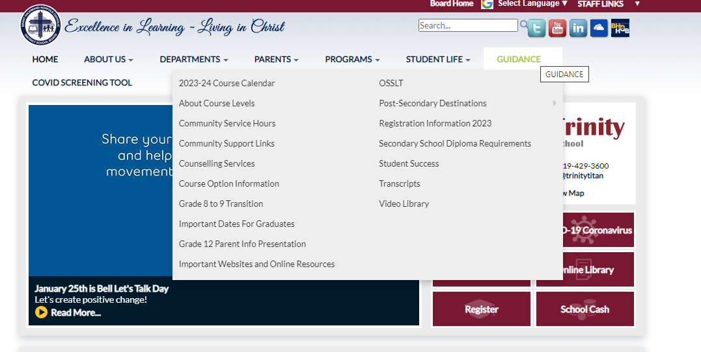
HOW DO I CHOOSE THE RIGHT ELECTIVES??
Notes:
I will quickly go through the elective choices you have for grade 11, but know that this information is found on our course guide which is linked here. Please open this link and go to page 27 to find Holy Trinity course offerings. You will also find our course offerings on MY blueprint once you log in. Please note that grade 11 students can choose grade 11 and grade 12 electives.

Slide 13
E-Learning
CLN4CE – Legal Studies
NBE3CE – Understanding Contemporary First Nations, Metis, and Inuit Voices (Sub for grade 11 College English)
NBE3UE - Understanding Contemporary First Nations, Metis, and Inuit Voices (Sub for grade 11 U English)​
Notes:
DUE DATES - In order to save a spot in the classes you want for grade 11, you must SUBMIT your course selections by the due date – Feb 22.

Slide 14
E-Learning
PPZ3CE – Health For Life
SVN3ME – Environmental Science
Understanding Contemporary First Nations, Metis, and Inuit Voices (Sub for grade 11 U English)​
Notes:
DUE DATES - In order to save a spot in the classes you want for grade 11, you must SUBMIT your course selections by the due date – Feb 22.

Slide 15
Summer School 2023
If summer school is part of your plan…take this into account when choosing courses.
You should choose your summer school courses BEFORE completing other course selection.

Slide 16
Summer School 2023
All summer school courses are e-learning and asynchronous
July 4th- 28th
Daily attendance required
MyBlueprint - Continuing Education tab

Slide 17
Grade 11 summer school choices
HRT3M – World Religions
HRF3O – World Religions
PPZ3C – Health for Life

Slide 18
GRADE 11 Summer school choices
MCF3M – Mixed Math
NBE3U – Understanding Contemporary First Nations, Metis, and Inuit Voices (Sub for grade 11 U English)
DCO3O2 – COOP
Credit Recovery

Slide 19
GRADE 12 SUMMER SCHOOL CHOICES
ENG4C – English College
ENG4U – English University
EWC4U - Writer’s Craft
MDM4U – Data Management
MAP4C– College Mathematics
OLC4O – Literacy Course
Notes:
Here are the grade 12 courses offered in summer school

Slide 20
Due dates
Courses are first come, first served. Don’t miss the deadline!
Collecting on Feb. 27th & 28th in homerooms.
5th year form must be submitted with Course Sign Off Sheet
Notes:
DUE DATES - In order to save a spot in the classes you want for grade 11, you must SUBMIT your course selections by the due date – Feb 22.

Slide 21
Permission granted
Interviews will be conducted by Vice Principals if required
Attendance and Behaviour taken into consideration.
Obligatory age of education = 18+
Notes:
DUE DATES - In order to save a spot in the classes you want for grade 11, you must SUBMIT your course selections by the due date – Feb 22.

Slide 22
How do I register?
Log In
Log into MyBlueprint to make grade 12 course selections.
Choose
Choose summer school option first (IF applicable)
Pick
Make all course selections
Remember
Once you hit submit, course selections will be locked in!

Slide 23
ALTERNATE CHOICE
Each student will need to add an ALTERNATE (elective) CHOICE
Choose a BACKUP Option that you would be happy with

Slide 24
Choose wisely
REMEMBER…
It is your future, and it is important to consider all post-secondary options

Slide 25
QUESTIONS /HELP
Your Surname​ | Counsellor Contact​
A – G | caitken@bhncdsb.ca​
H – Pa​ | cdeconinck@bhncdsb.ca ​
Pe - Z​ | rderoo@bhncdsb.ca ​
Notes:
That concludes the powerpoint part of my presentation for today.
If you have any questions, or require assistance please email your guidance counsellor to set up an appointment.

Slide 26
How do I register?
MyBLUEPRINT
myBlueprint
Notes:
Now I will take you to our school website .. To show you how to find this presentation, as well as to remind you how to use MY BLUEPRINT to sign up!

