Slide 1
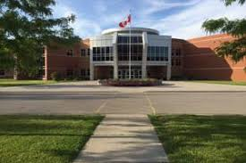

Making the transition to grade 11
Notes:
Hello everyone. I am Ms. Deroo from guidance, and I am here to share with you our Grade 11 Registration presentation. Please note that this slide show will be available on our website.
At the end of the presentation I will take you to our school website and show you where you can find the links I reference today.
Teachers – can you please ensure that your students have the ½ page yellow handout, as well as a pen/pencil handy. Thanks
Let’s begin

Slide 2
Diploma requirements
What do I need to graduate?
Ontario
Secondary
School
Diploma
Notes:
The goal of every high school student is to graduate with an OSSD or an OSSC.
In order to help you keep track of which courses you have completed, please pull out the yellow handout, as we will go through it together ☺

Slide 3
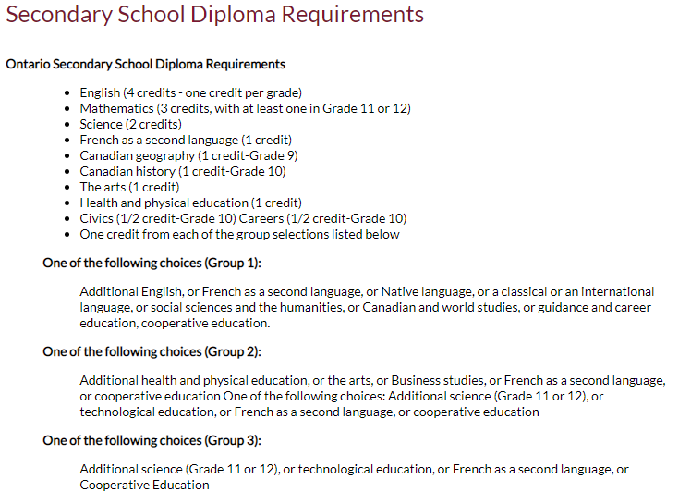
Diploma Requirements
Grade 11 Religion Counts!!
Notes:
Here are the compulsory high school credits you need - hopefully by the end of grade 10 you have completed the majority of your compulsory credits.
Together now, pick up your pencils. Note that beside ENGLISH there are 4 boxes – this is bc you require 4 English classes to graduate…. Assuming you have all SUCCESSFULLY completed your Grade 9 English, please go ahead and colour in the first box.
If you have successfly completed grade 10 English in quad 1 or 2, go ahead and colour in the second box, If you are currently enrolled in English, half colour in the second box.
Looking at the English row – you can easily see that you require 2 more English credits.
Carry on with yellow page.

Slide 4
Diploma requirements
4 Religion Credits
8 Optional Credits
40 hrs Community Service
Successful completion of the Literacy Test or Literacy Course
Notes:
The last slide showed the 18 compulsory credits
After that you require 3 more religion credits, and 8 optional credits.
you need 40 hours of community service, as well as successful completion of the literacy test or course.

Slide 5
Diploma requirements
2 ONLINE LEARNING CREDITS
A requirement beginning with students who entered Grade 9 in the 2020-21 school year – current grade 11s – unless you have OPTED OUT
“Opt Out Form” now available through MyBlueprint

Slide 6
Community Service Hrs
MUST BE NON-PROFIT ORGANIZATIONS/ AGENCIES/ EVENTS
Churches, hospitals, minor sports associations, Lions Club, Pumpkinfest, etc.
NOT dance academies, farmwork, businesses, horse stables, etc.
Notes:
The last slide showed the 18 compulsory credits
After that you require 3 more religion credits, and 8 optional credits.
you need 40 hours of community service, as well as successful completion of the literacy test or course.

Slide 7
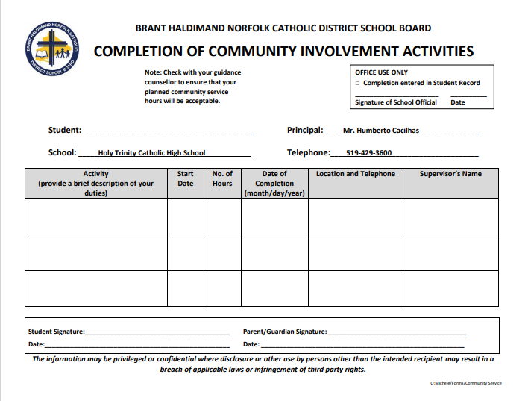
Notes:
Here is the form you will complete and submit to record your hours

Slide 8
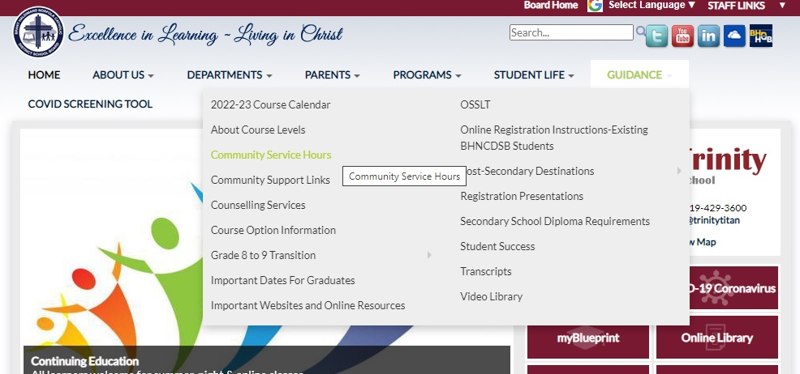
Community service
Notes:
Community Service Hours
Each student is required to complete 40 community service hours. We strongly encourage you to aim to complete your hours before September of your grade 12 year. For a list of eligible activities you can click on the first link,
For a community service hours form to complete, please click on the second link

Slide 9
Picking courses for Grade 11
Notes:
Picking courses for grade 11 is very different than grade 9 and 10 ….
For one – you will have 5 electives to choose from, rather than just 2
For two – grade 11 courses lead directly to grade 12 courses, which are often pre-requisites for specific college/university programs
For three– the language changes

Slide 10
Shift In Language
Course | Destination
Academic (D) | University (U)/ College (C)/ Workplace (E)
 | Mixed (M)
Applied (P) | College (C) / Workplace (E)
Locally - (L) Developed | Workplace (E)
Notes:
Academic courses in grade 10 lead to University courses in grade 11. Applied courses in grade 10 lead to College level courses in grade 11, and junior locally developed classes are transitioned into senior WORKPLACe level classes.
Please note that for some subjects there is also a MIXED level (which is a combination of college and university)

Slide 11
How do I choose the right level?
* Evaluate your grade 9/10 success
* Begin researching post-secondary destinations to see which level of education is required.
Evaluate your work habits and effort
Notes:
It is very important to evaluate BOTH your success and effort in grade 10.
We recommend at LEAST a mark of 70% in grade 10, if you want to continue classes at your current level of study. That means if you are studying at the applied level in grade 10, we would recommend a final grade of 70% to continue studying at the college level.

Slide 12
How do I choose the right level?
* Work at the highest level = more options for future
* Be honest with yourself:
        What are you good at?
        What do you enjoy?
        How much work are you willing to do?
Notes:
Read slide

Slide 13
Making Compulsory choices
English
Religion
Math
Minimum 5 electives
Notes:
FINALLY – you are registering for a senior grade – which means that instead of having 6 compulsory courses – you only have 3!!!
Assuming you have met all previous compulsory credits, In grade 11 you will have 3 compulsory credits, English and Religion and math.
This means you get to choose 5 electives!!!!
But .. Remember – that with freedom comes responsibility ☺
This is an exciting, and also very important time in planning for your grade 11 and 12 years
IT IS IMPORTANT THAT YOU START CONSIDERING YOUR POST-SECONDARY PLANS AT THIS TIME

Slide 14
ENGLISH
ENG3U – university
ENG3C – college
ENG3E – workplace
NBE3U – Understanding Contemporary First Nations, Metis, and Inuit Voices (Sub for grade 11 U English)​ NEW! Summer School
Notes:
English is offered at the U, C and Workplace levels

Slide 15
Religion
HRF3O – Open
HRT3M – Mixed/ ENG3U
Both offered as Summer School options
Notes:
English is offered at the U, C and Workplace levels

Slide 16
MATH
MCR3U - Functions
MCF3M1 – Mixed
MBF3C1 – College
MEL4E1 – Workplace (gr. 12)
Notes:
Picking the appropriate level of math for grade 11 is VERY important. You have to look back and ahead to make the correct choice. Looking ahead - Which level of math is required for the post-secondary options you are exploring .. Looking back – how did you do in your grade 10 math course.

Slide 17
Mathematics pathways
Make sure you have the appropriate pre-requisite for the Math course you need
Mathematics | Holy Trinity Catholic High School
Notes:
While a 4th math is not required for your OSSD, MANY college and university, as well as trades programs will require a grade 12 math credit. It is very important that you are prepared to take the appropriate math in grade 12
Here is a link to the math chart I will show you in the next slide

Slide 18
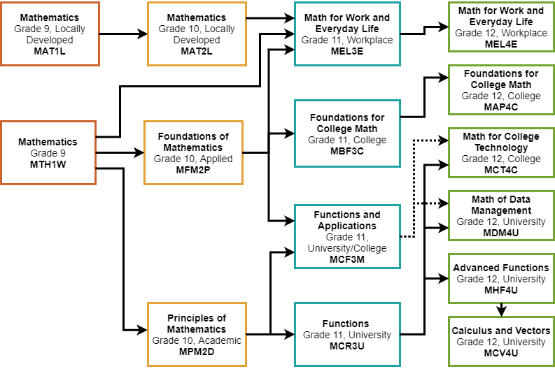

Slide 19
Planning Ahead
Some Grade 10/11 courses will be pre-requisites for specific grade 11/12 courses.
Example: SBI3U needs SNC2D
Notes:
Before we move on to the fun part (highlighting our elective classes), we will take the next couple of slides to be sure that you are planning ahead, thinking of both grade 11 and 12 when making your elective choices.

Slide 20

Plan Ahead – University Bound
Minimum of 6 grade 12 U/M courses required
Check pre-requisites & required average @
https://www.ontariouniversitiesinfo.ca/

Slide 21
Plan Ahead – Trades Bound
Check recommended courses and # of hours required
www.careersintrades.com
www.apprenticesearch.com
https://oyapskilledtrades.ca/

Slide 22
Plan ahead - trades
Math and Physics
Tech and Business
COOP / OYAP – credits + hours

Slide 23
Plan Ahead – College Bound
Check program prerequisites & minimum averages for competitive programs
Min 65% average for non-competitive programs
www.ontariocolleges.ca

Slide 24

Campus visits
GO VISIT YOUR TOP 3 CHOICES OF SCHOOLS DURING SPRING OPEN HOUSES OR ON YOUR P.D. DAYS

Slide 25
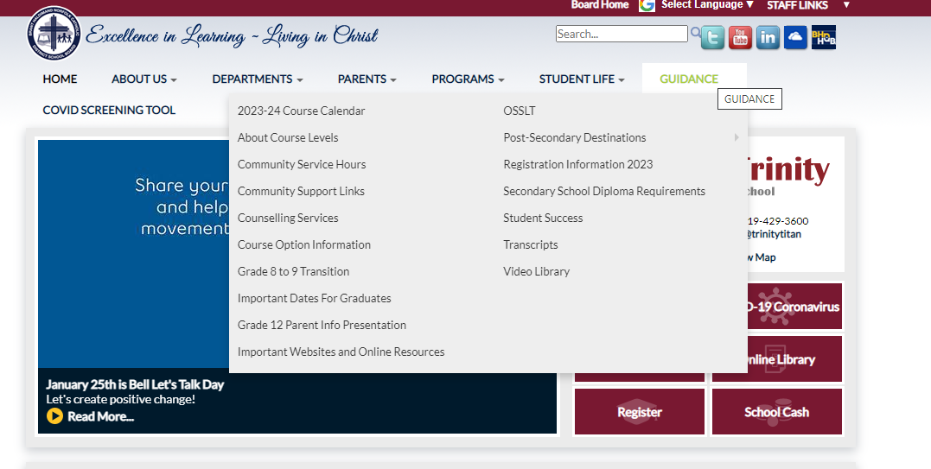
HOW DO I CHOOSE THE RIGHT ELECTIVES??
Notes:
I will quickly go through the elective choices you have for grade 11, but know that this information is found on our course guide which is linked here. Please open this link and go to page 27 to find Holy Trinity course offerings. You will also find our course offerings on MY blueprint once you log in. Please note that grade 11 students can choose grade 11 and grade 12 electives.

Slide 26
How do I choose the right electives??
* Look carefully at online Course Guide (page 26) and explore ALL possible choices. Note prerequisites.
* You can also log into my blueprint to see course descriptions
* View Elective Course Descriptions on website
Note: Grade 11s are welcome to take gr 12 electives
Notes:
I will quickly go through the elective choices you have for grade 11, but know that this information is found on our course guide which is linked here. Please open this link and go to page 27 to find Holy Trinity course offerings. You will also find our course offerings on MY blueprint once you log in. Please note that grade 11 students can choose grade 11 and grade 12 electives.

Slide 27
Shsm – Specialist High Skills Major
Customize your education to suit your interests and career plan
Learn sector specific skills and knowledge
Gain valuable work experience by completing a two-credit coop in your field
Acquire certifications that are specific to your field

Slide 28
HT SHSMs
SHSM Offerings:
Agriculture
Construction
Health and Wellness
Hospitality and Tourism
Sport
Transportation

Slide 29
Planning Ahead
SHSM Candidates:
There are required courses you need to complete your SHSM. Be sure to add required courses, as well as a ½ day coop to your course planning.

Slide 30
Elective Courses
ARTS
Drama (M)
Music (Instrumental, Vocal & Repertoire) (M)
Guitar (O)
Visual Art (M)
Photography (M)
Notes:
Elective courses in the arts include :

Slide 31
Elective Courses
BUSINESS AND COMPUTER STUDIES
Entrepreneurship (C)
Accounting (M)
Marketing (C)
Computer Science (U)

Slide 32
Elective Courses
CANADIAN WORLD STUDIES
American History (U)
Law (M)
Interdisciplinary (O) Financial and Legal Concepts for Everyday Life

Slide 33
Elective Courses
COOPERATIVE EDUCATION
Double Credit (O)
All Day Coop – choose twice

Slide 34
Elective Courses
ENGLISH
Media Studies (O)

Slide 35
Elective Courses
MODERN LANGUAGES
French (U)
French (O)
Extended French (U)

Slide 36
Elective Courses
GUIDANCE
Leadership (O)
Learning Strategies (O)

Slide 37
Elective Courses
HEALTH AND PHYSICAL EDUCATION
Physical Education (O)
Personal Fitness (O)
Hockey (O)
Volleyball (O)
Basketball (O) NEW!
Notes:
Elective courses in the arts include :

Slide 38
Elective Courses
SCIENCE
Biology (C or U)
Chemistry (U)
Physics (U)
Environmental Science (E)
Health Care (C or M)
Notes:
Elective courses in the arts include :

Slide 39
Elective Courses
SOCIAL SCIENCES & HUMANITIES
Families in Canadian Society (12U)
Intro to Anthropology, Psychology & Sociology (C or U)
Parenting/Working with Children (C/O)
Philosophy: The Big Questions (M) NEW!
Notes:
Elective courses in the arts include :

Slide 40
Elective Courses
TECHNOLOGY
Communications (M)
Computer Engineering (M)
Tech Design (M)
Transportation (C)
Green Industries (M)
Apparel & Textile/Interior Design (M)
Notes:
For c

Slide 41
Elective Courses
TECHNOLOGY
Construction (C)
Woodworking (E)
Notes:
We are offering both a college level, dual credit construction class, as well as a workplace level woodworking class. Be sure to read the difference and choose the right one for you.
The college level construction course is designed for students seriously interested in pursuing a career in the field. You will work with the tools, but also on blue print readings and building codes, as well as house planning principles.
The woodworking course focuses primarily on the use of construction tools
For Construction and Auto courses - I need to remind you that you are allowed to sign up for 1 course in each discipline each year. In other words, you can sign u for one Auto or construction class in grade 11, one in grade 12, but not two in grade 11

Slide 42
Elective Courses
TECHNOLOGY
Transportation (C)
Double credit: ½ day Transportation and Welding
Notes:
Note that if you sign up for the Double Auto and Welding courses – you cannot sign up for another auto course in the same year.

Slide 43
Elective Courses
TECHNOLOGY
Barbering (Gr 11)
Hairstyling & Aesthetics (E)
Cooking (E)
Baking (E)
Health Care (C or M)
Notes:
Elective courses in the arts include :

Slide 44
E-Learning
CLN4CE – Legal Studies
NBE3CE – Understanding Contemporary First Nations, Metis, and Inuit Voices (Sub for grade 11 College English)
NBE3UE - Understanding Contemporary First Nations, Metis, and Inuit Voices (Sub for grade 11 U English)​
Notes:
DUE DATES - In order to save a spot in the classes you want for grade 11, you must SUBMIT your course selections by the due date – Feb 22.

Slide 45
E-Learning
PPZ3CE – Health For Life
SVN3ME – Environmental Science
Notes:
DUE DATES - In order to save a spot in the classes you want for grade 11, you must SUBMIT your course selections by the due date – Feb 22.

Slide 46

Summer School 2023
If summer school is part of your plan…take this into account when choosing courses.
You should choose your summer school courses BEFORE completing your grade 11 registration.
MyBlueprint - Continuing Education tab
Notes:
This summer BHN will be offering a number of summer school courses. You will register for summer school using my blueprint. We strongly advice you to register for summer school before completing your Grade 12 registration

Slide 47
Summer School 2023
All summer school courses are e-learning and asynchronous
July 4th- 28th
Daily attendance required
MyBlueprint - Continuing Education tab

Slide 48
GRADE 11 Summer school choices
HRT3M – World Religions
HRF3O – World Religions
PPZ3C – Health for Life
SVN3E – Environ. Science
MCF3M – Mixed Math

Slide 49
GRADE 11 Summer school choices
NBE3U – Understanding Contemporary First Nations, Metis, and Inuit Voices (Sub for grade 11 U English)
DCO3O2 – COOP – two credits – 5 weeks + pre-placement in June
Credit Recovery

Slide 50
GRADE 9/ 10 Summer school choices
AWL1O – Visual Arts Drawing
PAF1O1 – Personal Fitness
PAF2O1 – Personal Fitness
ICS2O – Computer Studies
CHV2O – ½ credit Civics
GLC2O– ½ credit Career Studies
Both GLC/CHV2O Careers/ Civics
Credit Recovery

Slide 51
Due dates
Courses are first come, first served. Don’t miss the deadline!
Collecting on Feb. 27th & 28th in homerooms.
Sign Off Forms with parent signature & proof of payment – School Cash online - $35 Activity Fee
Notes:
DUE DATES - In order to save a spot in the classes you want for grade 11, you must SUBMIT your course selections by the due date – Feb 22.

Slide 52
How do I register?
Log In
Log into MyBlueprint to make grade 11 course selections.
Choose
Choose summer school option first (IF applicable)
Pick
Make all course selections
Remember
Once you hit submit, course selections will be locked in!
Notes:
Once again we will be using my blueprint to register for your courses.
If you plan to take summer school, be sure to complete the summer school registration on my blueprint first.
Remember that a parent’s signature is required
And once you hit submit, your course selections are locked in!
Please note at soon as I am done this presentation – I will show you a quick reminder of how to use myblueprint

Slide 53
ALTERNATE CHOICE
Each student will need to add an ALTERNATE (elective) CHOICE
Choose a BACKUP Option that you would be happy with
Notes:
Read screen - The alternate choice will be used if one of your first choice electives is not available, or if there is a conflict in your schedule.

Slide 54

Choose wisely
REMEMBER…
It is your future, and it is important to consider all post-secondary options

Slide 55
QUESTIONS /HELP
Your Surname​ | Counsellor Contact​
A – G | caitken@bhncdsb.ca​
H – Pa​ | cdeconinck@bhncdsb.ca ​
Pe - Z​ | rderoo@bhncdsb.ca ​
Notes:
That concludes the powerpoint part of my presentation for today.
If you have any questions, or require assistance please email your guidance counsellor to set up an appointment.

