Slide 1
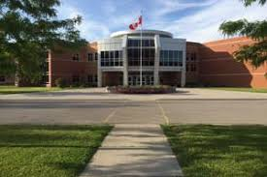
Making the transition to grade 10
Notes:
Hello everyone. I am Ms. Deroo from guidance, and I am here to share with you our Grade 11 Registration presentation. Please note that this slide show will be available on our website.
At the end of the presentation I will take you to our school website and show you where you can find the links I reference today.
Teachers – can you please ensure that your students have the ½ page yellow handout, as well as a pen/pencil handy. Thanks
Let’s begin

Slide 2
Diploma requirements
What do I need to graduate?
Ontario
Secondary
School
Diploma
Notes:
The goal of every high school student is to graduate with an OSSD or an OSSC.
In order to help you keep track of which courses you have completed, please pull out the yellow handout, as we will go through it together ☺

Slide 3
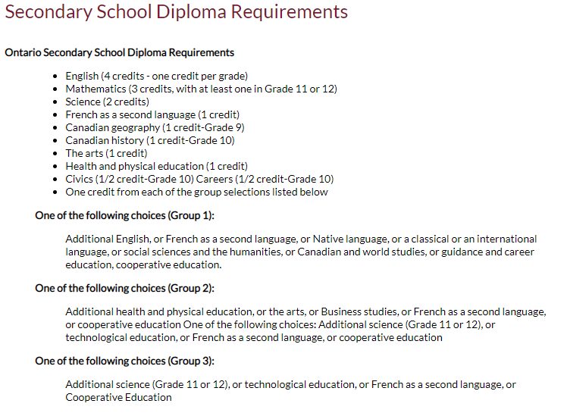
Diploma Requirements
Grade 11 Religion Counts!!
Notes:
Here are the compulsory high school credits you need - hopefully by the end of grade 10 you have completed the majority of your compulsory credits.
Together now, pick up your pencils. Note that beside ENGLISH there are 4 boxes – this is bc you require 4 English classes to graduate…. Assuming you have all SUCCESSFULLY completed your Grade 9 English, please go ahead and colour in the first box.
If you have successfly completed grade 10 English in quad 1 or 2, go ahead and colour in the second box, If you are currently enrolled in English, half colour in the second box.
Looking at the English row – you can easily see that you require 2 more English credits.
Carry on with yellow page.

Slide 4
Diploma requirements
4 Religion Credits
8 Optional Credits
40 hrs Community Service
Successful completion of the Literacy Test or Literacy Course
Notes:
The last slide showed the 18 compulsory credits
After that you require 3 more religion credits, and 8 optional credits.
you need 40 hours of community service, as well as successful completion of the literacy test or course.

Slide 5
Diploma requirements
2 ONLINE LEARNING CREDITS
Introduced in 2019.
A diploma requirement unless you have OPTED OUT
“Opt Out Form” now available through MyBlueprint

Slide 6
Community Service Hrs
MUST BE NON-PROFIT ORGANIZATIONS/ AGENCIES/ EVENTS
Churches, hospitals, minor sports associations, Lions Club, Pumpkinfest, etc.
NOT dance academies, farmwork, businesses, horse stables, etc.
Notes:
The last slide showed the 18 compulsory credits
After that you require 3 more religion credits, and 8 optional credits.
you need 40 hours of community service, as well as successful completion of the literacy test or course.

Slide 7
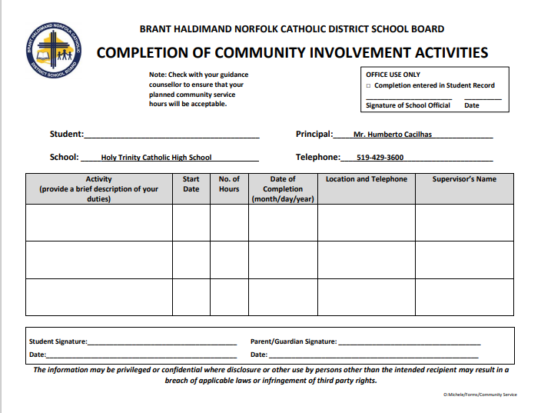
Notes:
Here is the form you will complete and submit to record your hours

Slide 8
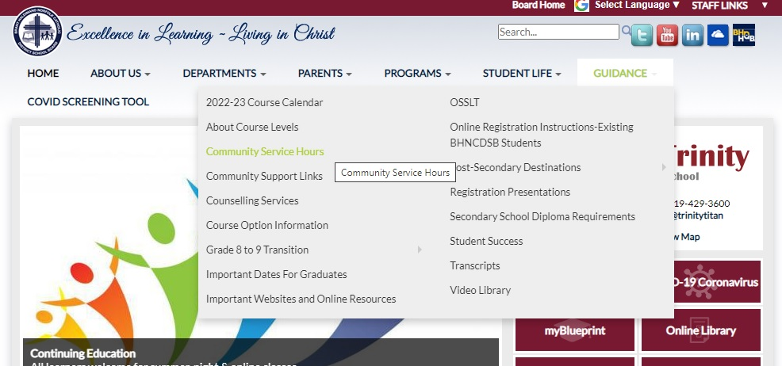
Community service
Notes:
Community Service Hours
Each student is required to complete 40 community service hours. We strongly encourage you to aim to complete your hours before September of your grade 12 year. For a list of eligible activities you can click on the first link,
For a community service hours form to complete, please click on the second link

Slide 9
Picking courses for Grade 10
Notes:
Picking courses for grade 11 is very different than grade 9 and 10 ….
For one – you will have 5 electives to choose from, rather than just 2
For two – grade 11 courses lead directly to grade 12 courses, which are often pre-requisites for specific college/university programs
For three– the language changes

Slide 10
Shift In Language
Course | Destination
Academic (D) | University/ College/ Work
Applied (P) | College / Work
Locally - (L) Developed | Work
Open (O) | All Electives
Notes:
Academic courses in grade 10 lead to University courses in grade 11. Applied courses in grade 10 lead to College level courses in grade 11, and junior locally developed classes are transitioned into senior WORKPLACe level classes.
Please note that for some subjects there is also a MIXED level (which is a combination of college and university)

Slide 11
ACADEMIC COURSES Grade 10
Best for students who:
Enjoy theory and analyzing results
Are abstract, reflective learners
Can work independently
Homework an expectation
Typically bound for university
D
Notes:
The lessons (learning modules) contained in this resource have been carefully constructed to maintain certain consistencies across all the divisions.
-These Overall Learning Goals remain the standard from Kindergarten right through to Grade 12.

Slide 12
APPLIED COURSES Grade 10
Best for students who:
Learn by doing
Learn from practical experiences
Like to relate learning to real-life examples
Need more assistance getting started
Typically bound for college, trades or work
P
Notes:
The lessons (learning modules) contained in this resource have been carefully constructed to maintain certain consistencies across all the divisions.
-These Overall Learning Goals remain the standard from Kindergarten right through to Grade 12.

Slide 13
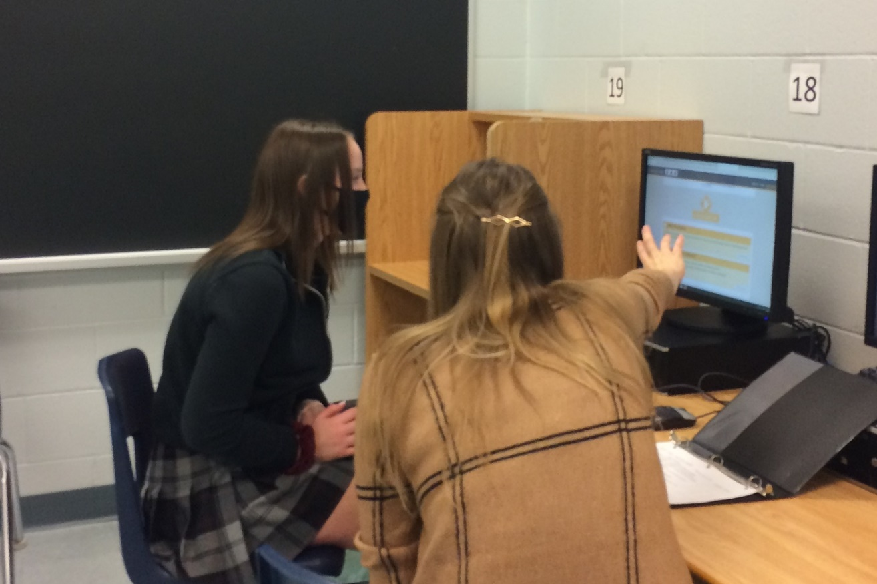
Locally- Developed Grades 9 & 10
Best for students who:
Small Teacher: Student ratio
Slower Pace
Learn by doing
Require additional support in the classroom
Typically bound for work or trades
L
Notes:
The lessons (learning modules) contained in this resource have been carefully constructed to maintain certain consistencies across all the divisions.
-These Overall Learning Goals remain the standard from Kindergarten right through to Grade 12.

Slide 14
How do I choose the right level?
* Evaluate your grade 9 success
* Begin researching post-secondary destinations to see which level of education is required.
Evaluate your work habits and effort
Notes:
It is very important to evaluate BOTH your success and effort in grade 10.
We recommend at LEAST a mark of 70% in grade 10, if you want to continue classes at your current level of study. That means if you are studying at the applied level in grade 10, we would recommend a final grade of 70% to continue studying at the college level.

Slide 15
How do I choose the right level?
* Work at the highest level possible = more options in the future
* Be honest with yourself:
What are you good at?
What do you enjoy?
How much work are you willing to do?
Notes:
Read slide

Slide 16
Making Compulsory choices
English
Religion
Math
History
Careers/ Civics
Science
Notes:
FINALLY – you are registering for a senior grade – which means that instead of having 6 compulsory courses – you only have 3!!!
Assuming you have met all previous compulsory credits, In grade 11 you will have 3 compulsory credits, English and Religion and math.
This means you get to choose 5 electives!!!!
But .. Remember – that with freedom comes responsibility ☺
This is an exciting, and also very important time in planning for your grade 11 and 12 years
IT IS IMPORTANT THAT YOU START CONSIDERING YOUR POST-SECONDARY PLANS AT THIS TIME

Slide 17
ENGLISH
ENG2P – applied
ENG2D – academic
ENG2L – locally developed
Notes:
English is offered at the U, C and Workplace levels

Slide 18
MATH
MFM2P1 - applied
MDM2D1 – academic
MAT2L1 – Locally Developed
Notes:
Picking the appropriate level of math for grade 11 is VERY important. You have to look back and ahead to make the correct choice. Looking ahead - Which level of math is required for the post-secondary options you are exploring .. Looking back – how did you do in your grade 10 math course.

Slide 19
Mathematics pathways
Make sure you have the appropriate pre-requisite for the Math course you need
Mathematics | Holy Trinity Catholic High School
Notes:
While a 4th math is not required for your OSSD, MANY college and university, as well as trades programs will require a grade 12 math credit. It is very important that you are prepared to take the appropriate math in grade 12
Here is a link to the math chart I will show you in the next slide

Slide 20
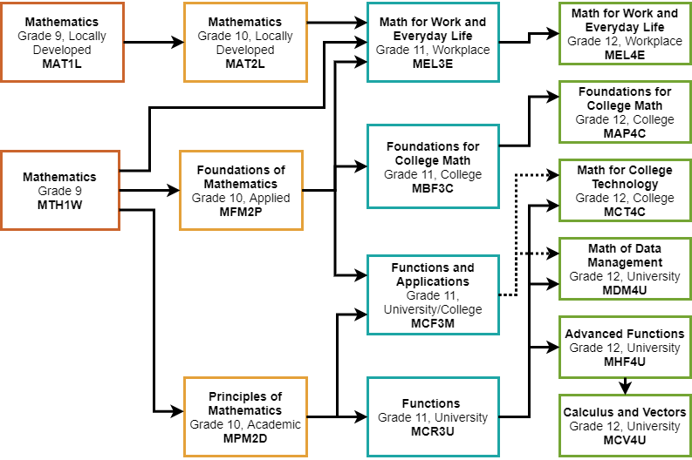

Slide 21
Science
SNC2P – applied
SNC2D – academic
SNC2L – locally developed
Notes:
English is offered at the U, C and Workplace levels

Slide 22
History
CHC2P – applied
CHC2D – academic
CHC2L – locally developed
Notes:
English is offered at the U, C and Workplace levels

Slide 23
Religion
HRE2O – open
HRE2OA – Arts Focus (prerequisite AVI1O)
Notes:
English is offered at the U, C and Workplace levels

Slide 24
Careers/ Civics
GLC2O– Careers ½ credit
CHV2O– Civics ½ credit
Notes:
English is offered at the U, C and Workplace levels

Slide 25
Planning Ahead
Some Grade 10 courses will be pre-requisites for specific grade 11 courses.
Example: SBI3U needs SNC2D; AWQ3O needs AVI1O
Notes:
Before we move on to the fun part (highlighting our elective classes), we will take the next couple of slides to be sure that you are planning ahead, thinking of both grade 11 and 12 when making your elective choices.

Slide 26
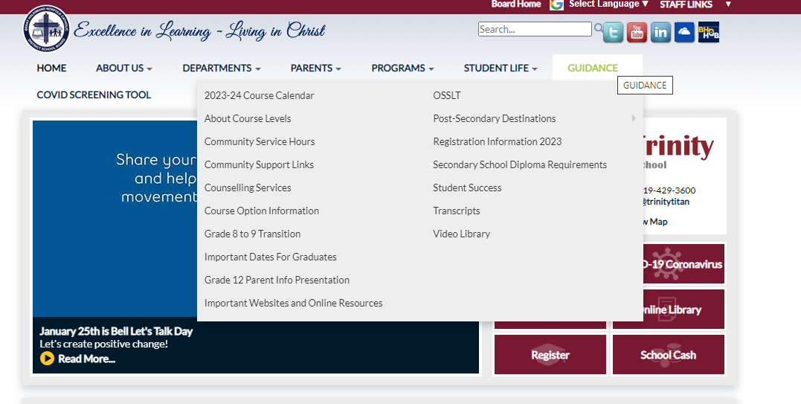
HOW DO I CHOOSE THE RIGHT ELECTIVES??
Notes:
I will quickly go through the elective choices you have for grade 11, but know that this information is found on our course guide which is linked here. Please open this link and go to page 27 to find Holy Trinity course offerings. You will also find our course offerings on MY blueprint once you log in. Please note that grade 11 students can choose grade 11 and grade 12 electives.

Slide 27
How do I choose the right electives??
* Look carefully at online Course Guide (page 26) and explore ALL possible choices. Note prerequisites.
* You can also log into my blueprint to see course descriptions
* View Elective Course Descriptions on website
Note: Grade 10s are welcome to take gr 11 electives – especially those focused on sciences/ math
Notes:
I will quickly go through the elective choices you have for grade 11, but know that this information is found on our course guide which is linked here. Please open this link and go to page 27 to find Holy Trinity course offerings. You will also find our course offerings on MY blueprint once you log in. Please note that grade 11 students can choose grade 11 and grade 12 electives.

Slide 28
Elective Courses
ARTS
Drama (O)
Music (Instrumental & Vocal) (O)
Guitar (O)
Visual Art (O)
Notes:
Elective courses in the arts include :

Slide 29
Elective Courses
BUSINESS AND COMPUTER STUDIES
Introduction to Business (½ credit); Information Technology (½ credit)
Computer Studies(O)

Slide 30
Elective Courses
MODERN LANGUAGES
French (P & D)
Extended French (D)

Slide 31
Elective Courses
GUIDANCE
Learning Strategies (O)

Slide 32
Elective Courses
HEALTH AND PHYSICAL EDUCATION
Physical Education (O)
Personal Fitness (O)
Volleyball (O)
Hockey (gr 9/10)
Notes:
Elective courses in the arts include :

Slide 33
Elective Courses
TECHNOLOGY
Communications (O)
Hospitality & Tourism (O)
Tech Design (O)
Transportation (O)
Hairstyling & Aesthetics (O)
Construction (O)
Computer Engineering (O)
Notes:
For c

Slide 34
Summer School 2023
If summer school is part of your plan…take this into account when choosing courses.
You should choose your summer school courses BEFORE completing your grade 10 registration.
MyBlueprint - Continuing Education tab
Notes:
This summer BHN will be offering a number of summer school courses. You will register for summer school using my blueprint. We strongly advice you to register for summer school before completing your Grade 12 registration

Slide 35
Summer School 2023
All summer school courses are e-learning and asynchronous
July 4th- 28th
Daily attendance required
MyBlueprint - Continuing Education tab

Slide 36
GRADE 9/ 10 Summer school choices
AWL1O – Visual Arts Drawing
PAF1O1 – Personal Fitness
PAF2O1 – Personal Fitness
ICS2O – Computer Studies
CHV2O – ½ credit Civics
GLC2O– ½ credit Career Studies
Both GLC/CHV2O Careers/ Civics
Credit Recovery

Slide 37
Due dates
Courses are first come, first served. Don’t miss the deadline!
Collecting on Feb. 27th & 28th in homerooms.
Sign Off Forms with parent signature & proof of payment – School Cash online - $35 Activity Fee
Notes:
DUE DATES - In order to save a spot in the classes you want for grade 11, you must SUBMIT your course selections by the due date – Feb 22.

Slide 38
How do I register?
Log In
Log into MyBlueprint to make grade 10 course selections.
Choose
Choose summer school option first (IF applicable)
Pick
Make all course selections
Remember
Once you hit submit, course selections will be locked in!
Notes:
Once again we will be using my blueprint to register for your courses.
If you plan to take summer school, be sure to complete the summer school registration on my blueprint first.
Remember that a parent’s signature is required
And once you hit submit, your course selections are locked in!
Please note at soon as I am done this presentation – I will show you a quick reminder of how to use myblueprint

Slide 39
ALTERNATE CHOICE
Each student will need to add an ALTERNATE (elective) CHOICE
Choose a BACKUP Option that you would be happy with
Notes:
Read screen - The alternate choice will be used if one of your first choice electives is not available, or if there is a conflict in your schedule.

Slide 40
QUESTIONS /HELP
Your Surname​ | Counsellor Contact​
A – G | caitken@bhncdsb.ca​
H – Pa​ | cdeconinck@bhncdsb.ca ​
Pe - Z​ | rderoo@bhncdsb.ca ​
Notes:
That concludes the powerpoint part of my presentation for today.
If you have any questions, or require assistance please email your guidance counsellor to set up an appointment.

Slide 41
How do I register?
MyBLUEPRINT
myBlueprint
Notes:
Now I will take you to our school website .. To show you how to find this presentation, as well as to remind you how to use MY BLUEPRINT to sign up!

