Slide 1

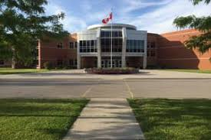
Making the transition to grade 12
Notes:
Welcome to the Grade 12 Registration presentation. Please note that this slide show is being recorded and will be available on our website.

Slide 2
Diploma Requirements
Ontario
Secondary
School
Diploma
Secondary School Diploma Requirements | Holy Trinity Catholic High School
Notes:
The goal of every high school student is to graduate with an OSSD (Ontario secondary school diploma) or an OSSC (Ontario secondary school certificate).
This link will take you directly to our trinitycatholic webpage where both OSSD and OSSC requirements are outlined
We will follow this link now

Slide 3
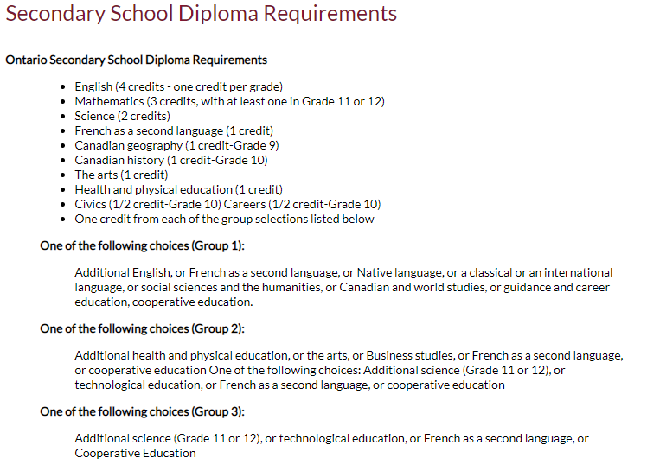
Diploma Requirements
Grade 11 Religion Counts!!
Notes:
We have gone over these requirements with you each year, and hopefully you have completed the majority of your compulsory credits. You will be receiving your report card in the mail shortly, you can use the course accumulation sheet on the back of the report card to help identify any compulsory credit you may still require.
Catholic Secondary School Diploma Requirements include 4 things
1. 30 credits, 18 of which are compulsory
2. As well as religion credits, a literacy component and community hours which I will explain in the next slide

Slide 4
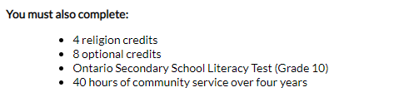
Notes:
Other graduation requirements include:
Completing 12 more optional courses (including your grade 9, 10 and 12 religion classes)
40 hours of community service
And successful completion of either the grade 10 literacy test or the grade 12 literacy course.

Slide 5
LITERACY TEST UPDATE
The ministry will pilot an online literacy test this spring.
Students who attempt the test and do not pass will be given an opportunity to complete the test or the course in grade 12
Notes:
Read slide
If you do not pass the literacy test in grade 11, you can either retry the test in grade 12, or complete the literacy course either in summer school or in September of your grade 12 year.

Slide 6
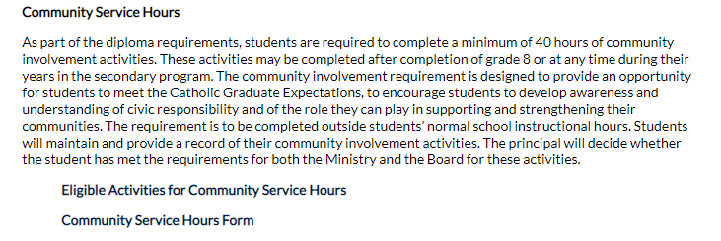
Notes:
Community Service Hours
Each student is required to complete 40 community service hours. We strongly encourage you to aim to complete your hours before September of your grade 12 year. For a list of eligible activities you can click on the first link,
For a community service hours form to complete, please click on the second link

Slide 7
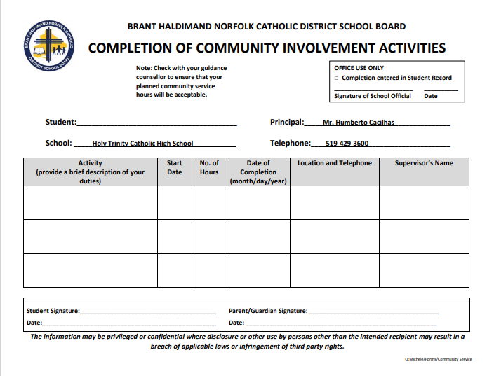
Notes:
Here is the form you will complete and submit to record your hours

Slide 8
Making Compulsory choices
English
Religion
Minimum of 4 electives
Notes:
Grade 12 courses continue at the University, College, Mixed, Workplace and Open Levels.
Assuming you have met all previous compulsory credits, In grade 12 you will have 2 compulsory credits, English and Religion.
Grade 12 students must choose a minimum of 6 courses

Slide 9
ENGLISH
ENG4U – university
ENG4C – college
ENG4E – workplace
ENG4USS – university (summer school)
ENG4CSS – college (summer school)
Notes:
You can take your grade 12 English at the university, college or workplace level.
Both the college and university level courses will be offered in regular day school, as well as summer school

Slide 10
religion
HRE4M1
HRE4O1
Notes:
You can take your grade 12 RELIGION course at the open or mixed level

Slide 11
Mathematics pathways
Make sure you have the appropriate pre- requisite for the Math course you want
Mathematics | Holy Trinity Catholic High School
Notes:
While a 4th math is not required for your OSSD, MANY college and university, as well as trades programs will require a grade 12 math credit. It is very important that you are prepared to take the appropriate math in grade 12
Here is a link to the math chart I will show you in the next slide

Slide 12
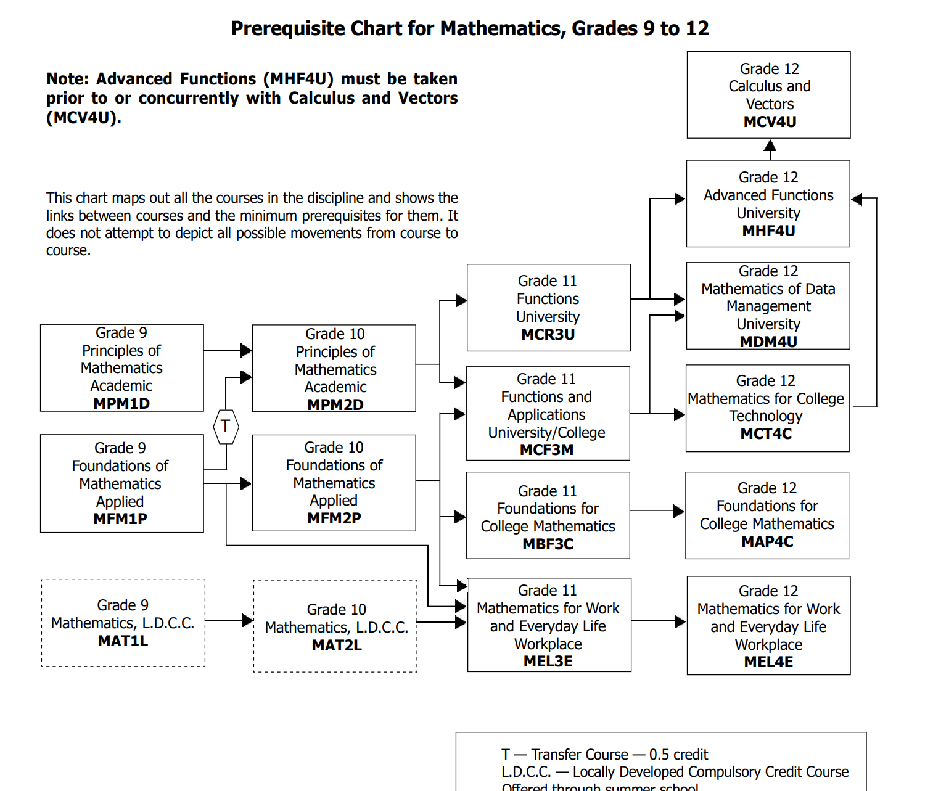
Notes:
Here is a math chart for your reference. At this stage of the game I would look at the far right column and work backward. If the program you want requires MDM4U (data), note that you can get there from either the MCF3M or MCR3U course.
PLEASE NOTE: If you are interested in a college program that requires MCT4C (math for college technology), this course requires MCF3M as a pre-requisite. MCF3M and MCT4C are both being offered in summer school

Slide 13
Planning for Post Secondary
Grade 11 Postsecondary Presentation - YouTube
Notes:
The following 3 slides speak to University, College and Apprenticeships. Please take the time to watch the video linked here. It is an hour long presentation that was created for grade 11 students and parents. Feel free to scroll to the post-secondary option that interests you.

Slide 14
Plan Ahead – University Bound
Minimum of 6 grade 12 U/M courses required
Check pre-requisites & required average @
https://www.ontariouniversitiesinfo.ca/
Notes:
Here is a brief description
University bound students need a min of 6 grade 12 U/M credits. It is important to check the pre-requisites required for the program you are interested in.
Use this link to continue research, to find programs, pre-requisites and cut off averages

Slide 15
Plan Ahead – Trades Bound
Check recommended courses and # of hours required
www.careersintrades.com
www.apprenticesearch.com
Math and Physics
Tech and Business
Combine COOP credits plus OYAP and earn hours toward your apprenticeship while still in high school
Notes:
If interested in the trades, again, please watch that video shared on the earlier slide, and use these websites to continue your research. Most trades will require a grade 12 math, and often recommend grade 12 physics. We also STRONGLY recommend a high school coop, tech course, as well as business classes. Remember that on the job hours in a high school coop count toward your apprenticeship hours.

Slide 16
Plan Ahead – College Bound
Check program prerequisites & minimum averages for competitive programs
Min 65% average for non-competitive programs
www.ontariocolleges.ca
Notes:
College programs also have specific pre-requisites, often courses at both the grade 11 and 12 levels. Again, please watch the video, and use this website to assist in your research. Please note that the cut-off average for Highly competitive programs is MUCH higher than 65%. Do your research!

Slide 17
VISIT SCHOOLS
GO VISIT YOUR TOP 3 CHOICES OF SCHOOLS DURING SPRING OPEN HOUSES OR ON YOUR P.A. DAYS
Notes:
Typically we would encourage you to visit your top choices of school, but unfortunately with COVID that is not possible at this time. In lieu of an on campus visit, we encourage you to take part in the virtual tours that all campus’s are offering. Join a virtual presentation and/or use the CHAT feature to speak with liaison officers from the college or university you are considering.

Slide 18
CHANGING PATHWAYS
university
If you are considering changing pathways – please speak with your guidance counsellor
college
workplace
Notes:
Read slide

Slide 19
How do I choose the right electives??
* Look carefully at online Course Guide BHNCDSB-Couse_Calendar-21-22.pdf (trinitycatholic.ca) and explore ALL possible choices. Note prerequisites
* You can also log into my blueprint to see course descriptions
Grade 12s are welcome to take gr 11 & gr 12 electives
Notes:
I will quickly go through the elective choices you have for grade 12, but know that this information is found on our course guide which is linked here. Please open this link and go to page 32 to find Holy Trinity course offerings. You will also find our course offerings on MY blueprint once you log in. Please note that grade 12 students can choose grade 11 and grade 12 electives.

Slide 20
Elective Courses
ARTS
Drama (M)
Music (Instrumental, Vocal & Repertoire) (M)
Guitar (O) - NEW
Visual Art (M)
Photography (M)
Portfolio Building (M)
Notes:
Elective courses in the arts include :

Slide 21
Elective Courses
BUSINESS AND
COMPUTER STUDIES
Accounting (M)
Business Leadership (M)
Computer Studies (U)
Economics (U)
Notes:
Elective courses in business include:

Slide 22
Elective Courses
CANADIAN & WORLD STUDIES
World Issues (U)
World History(U)
Economics (U)
Notes:
Elective courses in cdn and world studies include:

Slide 23
Elective Courses
CO-OP
Double Credit (O)
If you want an all day
co-op choose DCO3OC twice

Slide 24
Elective Courses
MODERN LANGUAGES
French (U)
French – (O)
Extended French (U)
ENGLISH
Writer’s Craft (U)
Literacy Course (O)
ESL (O)
Notes:
Elective coruses in modern languages and English include:

Slide 25
Elective Courses
HEALTH AND PHYSICAL EDUCATION
Physical Education (O)
Personal Fitness (O)
Basketball (O)
Kinesiology (U)
Volleyball [gr 11]
EALTH & PHYS ED
Notes:
Electives in physed include:

Slide 26
Elective Courses
SCIENCE
Biology (U)
Chemistry (U or C)
Physics (U or C)
Health Science (M)
Health Care (C or E)
Notes:
Electives in science include:

Slide 27
Elective Courses
SOCIAL SCIENCE & HUMANITIES
Challenge and Change in Society (U)
Philosophy (U)
INTERDISCIPLINARY
Peer Tutoring (U)

Slide 28
Elective Courses
TECHNOLOGY
Communications (M)
Computer Engineering (M)
Construction (C)
Custom Woodworking (E)
Tech Design (M)
Architectural Design (M)
Transportation (C)
TECHNOLOGY
Barbering (Grade 11)new
Hairstyling & Aesthetics (E)
Cooking (E) single credit
Cooking - double credit Chef Training
Baking: single or double credit in Advanced Baking
Notes:
Electicve in technology include

Slide 29
Summer School 2021
It is very important to plan for summer school immediately.
You should choose your summer school courses BEFORE completing your grade 12 registration.
Please click link below to see summer course offerings
myBlueprint
Notes:
This summer BHN will be offering a number of summer school courses. You will register for summer school using my blueprint. We strongly advice you to register for summer school before completing your Grade 12 registration

Slide 30
GRADE 12 SUMMER SCHOOL CHOICES
ENG4C – English NEW
ENG4U – English
HIP4O1 – Personal Life Mgmt
GLN4O – Navigating the workplace NEW
OLC4O – Literacy Course
EWC4U – Writer’s Craft NEW
MCT4C – Math for College Technology NEW
DCO3O2 – COOP
Credit recovery
Notes:
Here are the grade 12 courses offered in summer school

Slide 31
GRADE 11 Summer school choices
HRT3M –Religion
HRF3O –Religion NEW
PPZ3C – Health for Life
SVN3E – Environ. Science
GPP3O – Leadership NEW
MCF3M – Mixed Math NEW
EMS3O – Media Studies NEW
DCO3O2 – COOP
Credit Recovery

Slide 32
SHSM
Specialist High skill major
http://www.trinitycatholic.ca/page/shsm
Sector specific courses
Coop
Notes:
If you are enrolled in a SHSM it is important that you register to take all of the sector specific required courses, as well as the double credit coop if you haven’t done so already. If you are struggling to fit it all in, please consider a summer school coop. Speak to your guidance counsellor if you need help. The link provided will take you to the SHSM page on our website.

Slide 33
SHSM – Specialist High Skills Major
Agriculture (Green Industries)
Health and Wellness
Health and Wellness – Fitness Focus
Hospitality and Tourism
Transportation
http://www.trinitycatholic.ca/page/shsm
Notes:
Holy Trinity offers SHSM in the following disciplines:
List them
If you are dedicated to a career path in any of these areas, please follow the link provided to learn more information

Slide 34
DUE DATES
Courses are first come, first served.
Do NOT miss the deadlines!
Registration forms will be collected first period on February 23rd

Slide 35
How do I register?
Log into myblueprint to make grade 12 course selections.
Choose summer school first
Remember that a parent’s signature is mandatory
Once you hit submit, course selections will be locked in!
Notes:
Once again we will be using my blueprint to register for your courses.
If you plan to take summer school, be sure to complete the summer school registration on my blueprint first.
Remember that a parent’s signature is required
And once you hit submit, your course selections are locked in!
Please note that following this presentation Ms. Aitken will be sharing a short HOW TO REGISTER on MY BLUEPRINT reminder video for you. This video can be found on our school website under the guidance tab.

Slide 36
ALTERNATE CHOICE
Each student will need to add an ALTERNATE (elective) CHOICE
Choose a BACKUP Option that you would be happy with
Notes:
Read slide
The alternate choice will be used if one of your first choice electives is not available, or if there is a conflict in your schedule.

Slide 37

REMEMBER
It is your future, and it is important to consider all post secondary options
CHOOSE WISELY

Slide 38
QUESTIONS /HELP
Your Surname​ | Counsellor Contact​
A – Go​ | caitken@bhncdsb.ca​
Gr – O​ | svanleeuwen@bhncdsb.ca ​
P - Z​ | rderoo@bhncdsb.ca ​
Notes:
That concludes my presentation for today.
If you have any questions, or require assistance please email your guidance counsellor to set up an appointment.

