Slide 1
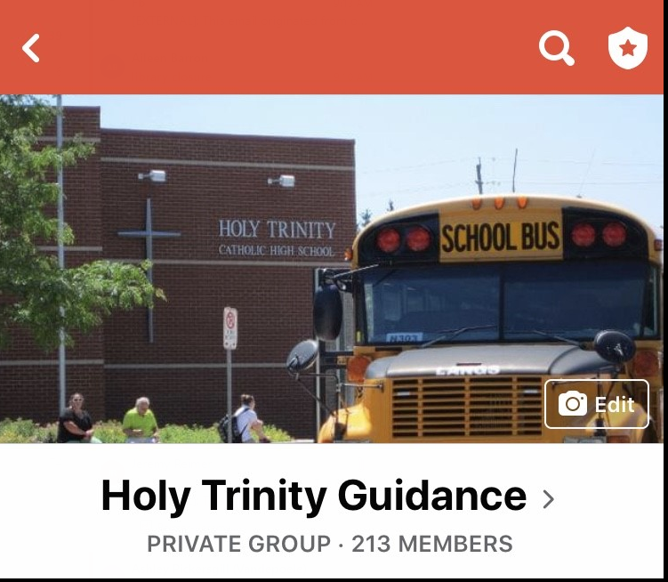
For Timely Updates from HT
Morning announcements:
http://www.trinitycatholic.ca/ht-announcements
Check email regularly
Follow us on twitter @trinitytitan
Follow us on Facebook
@ Holy Trinity Guidance
Notes:
ROBBYN Have this screen available to parents while we wait for all to join
“Welcome, We will begin the presentation shortly.”

Slide 2
Grade 12 Parent Information Night
October 12tH, 2022

Slide 3
Agenda
Graduation
Important dates
Post-Secondary Pathways
Financing Your Education (Kings College – UWO)

Slide 4
Graduation 2023
Wednesday June 28th, 2023
Students must register for grad by Feb. 1st
Grad Mass, Grad Breakfast, Rehearsal
Ceremony in evening

Slide 5
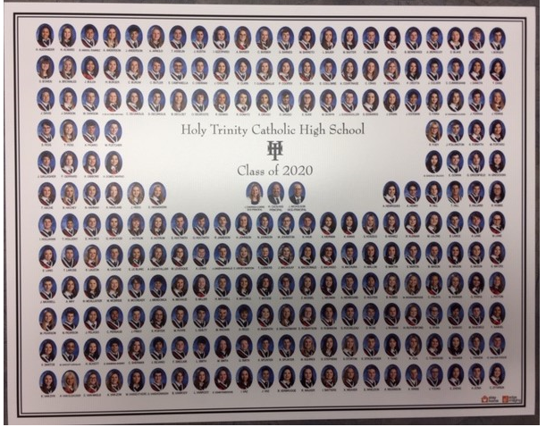
Graduation
GRAD FEE - $75
Breakfast
Reception
Composite Picture
Purchase of Gown & Sash
Sitting fee – Grad Photos – Nov. 14 - 17th

Slide 6
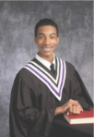
Graduation Photos
Nov 14th – 19th
@ Holy Trinity
Students will book their own date and time with the link they will be emailed by the end of October (once PMT received)

Slide 7
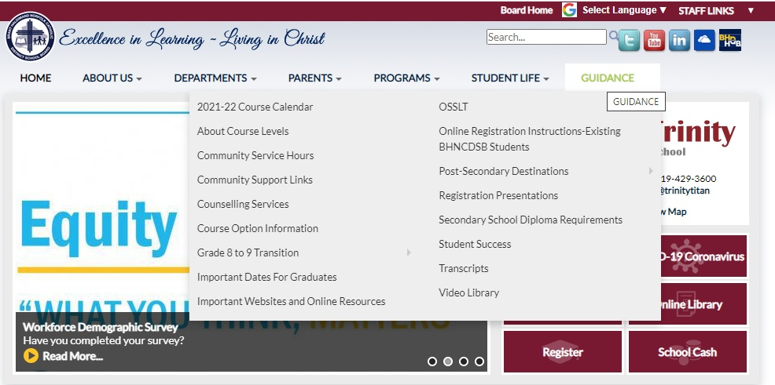
Community Service Hours
40 hours
Deadline- Fri. Dec. 23rd
Electronic form accessible HERE OR available in Guidance

Slide 8
Grad Hoodie

Slide 9
Graduation
AWARDS AT GRADUATION
Academic award
Ontario scholar
Titan award/School letter - Click Here
Top mark awards
School & Community sponsored awards

Slide 10
School & Community Awards
Financing Your Education | Holy Trinity Catholic High School

Slide 11
What we have been up to…
Grad meeting – Sept 12 Liaison visits – Sept – November Individual Grade 12 visits

Slide 12
Important Deadlines
Full disclosure dates for Semester1
Monday November 28, 2022
Deadline to apply to university – Jan 12th
Deadline to apply to college – Feb 1st
(BUT WE RECOMMEND TO APPLY EARLY!!)
Deadline Register for Graduation – Feb 1st
http://www.trinitycatholic.ca/page/important-dates-guidance

Slide 13
Important Dates & Presentations
Grade 12 Trades Presentation – Oct. 13th
College Fair Trip (Niagara College) – Oct. 17th
How to apply to college Oct. 18th and 20th
College Panel – Thursday October 27
How to apply to university Nov. 8th
Liaison Visits with colleges and universities

Slide 14
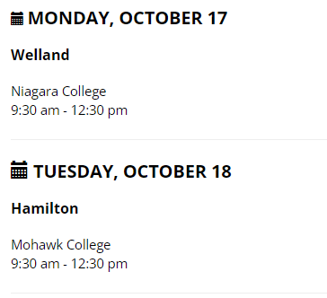
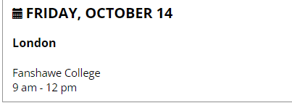
Important Dates and Research
Ontario College Information Program (CIP)
College Information Program (CIP) - Schedule | ontariocolleges.ca

Slide 15
College Mondays Weekly online sessions designed to connect learners and parents with representatives from each college.
College Mondays | ontariocolleges.ca

Slide 16
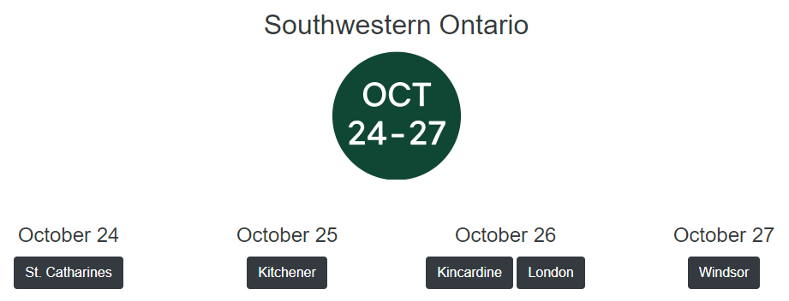
Important Dates and Research
Ontario Universities IN PERSON Fairs
Welcome to the Largest Postsecondary Educational Fair in Canada | OUF (ontariouniversitiesfair.ca)

Slide 17
Important Dates and Research
Ontario Universities VIRTUAL Fairs
Welcome to the Largest Postsecondary Educational Fair in Canada | OUF (ontariouniversitiesfair.ca)

Slide 18
PATHWAYS

Slide 19
Skilled Trades Bound
Trades presentation – Thurs. Oct 13th, 2022
** you must pre-register on Ms. Deroo door
“How to apply to college” session
http://www.trinitycatholic.ca/guidance/important-websites-and-online-resources

Slide 20
Skilled Trades Bound
CREDENTIAL – Journeyperson
Apprenticeship hours (3-5 years)
Level I, II, III training (500 - 900 hours)
Traditional apprenticeship
College Certificates
College Diploma

Slide 21
Skilled Trades Bound
Co-op & job shadowing
College Math and Physics
Tech courses
Business courses
http://www.trinitycatholic.ca/guidance/important-websites-and-online-resources

Slide 22
Workplace
Workplace planning board
https://workforceplanningboard.org/
Fanshawe career center
https://www.fanshawec.ca/student-life/campus-services/employment/community-career-and-employment-services
Norfolk Business
https://www.norfolkbusiness.ca/job-postings/
http://www.trinitycatholic.ca/guidance/important-websites-and-online-resources
Job bank
www.jobbank.gc.ca

Slide 23
Workplace
Job search skills
Resume and cover letter
Interview skills
Network, network, network
Through part-time employment
Through coop
Employment Centre

Slide 24
University Bound
“How to apply” session – Tues. Nov. 8th
OUAC “Pins” and Passwords
January 12th – DEADLINE to apply to OUAC
HT’s deadline for OUAC -Prior to Christmas
Nov., Feb., April., July – marks to Universities

Slide 25
University Bound
RESEARCH, RESEARCH, RESEARCH
www.ouinfo.ca
Liaison Visits

Slide 26
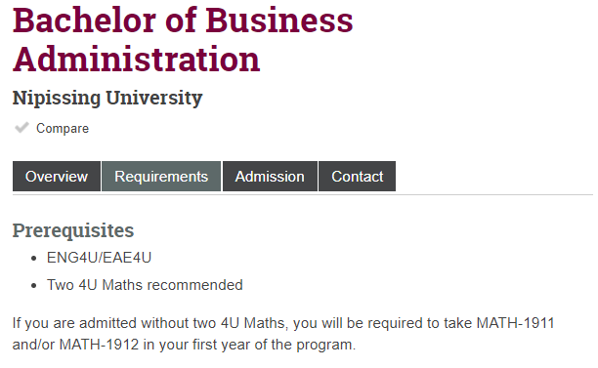
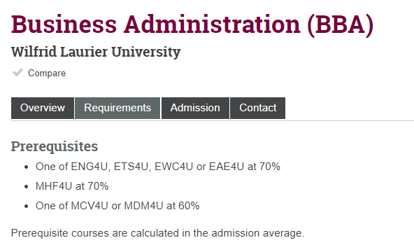
University Bound
Min. Admission req - 6 grade 12 U/M courses
Program specific requirements

Slide 27
College bound
CREDENTIALS
Certificates
Diploma
Advanced Diploma
Bachelor Degree
Graduate Certificates

Slide 28
College bound
“How to apply to College” sessions
February 1st, 2023 – equal consideration
Suggested deadline: November 1st, 2022

Slide 29
College bound
Nov., Feb., April and July – marks transmitted
Research, Research, Research
programs, credentials, admission requirements, highly competitive, campus locations, etc.
www.ontariocolleges.ca

Slide 30
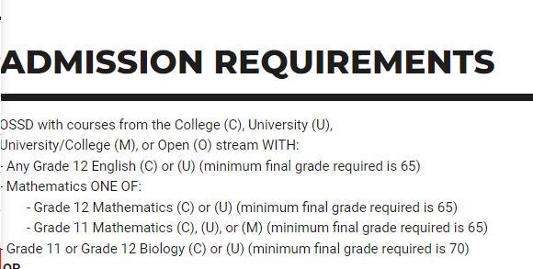
Admission Requirements

Slide 31
Campus visits
We believe a campus visit is essential when deciding which post-secondary institution is right for you
Please watch for updates from campuses… as soon as they open, I would strongly encourage a campus visit

Slide 32
Not sure???
Niagara college - career coach
Occupational Data | Planning and Institutional Research | Niagara College
Humber - career finder
Humber College | Find Your Match! (humbercareerfinder.com)
Sheridan – Idea generator
Sheridan | Idea Generator (sheridancollege.ca)
Fanshawe pathfinder
Fanshawe Pathfinder

Slide 33
Returning to HT??
Need to complete registration in February and complete an additional form for approval by a VP
A good idea:
Need post-secondary (required) courses
Coop experience
A bad idea:
“Because I don’t know what I want to do”
Often wish they hadn’t & then drop out

Slide 34
Financing your Post Secondary Education

Slide 35
Visit schools ASK QUESTIONS … visit schools ASK QUESTIONS … Ask more questions

Slide 36
OSAP Aid Estimator for Full-Time Students: Home Page (gov.on.ca)

